Slide 1

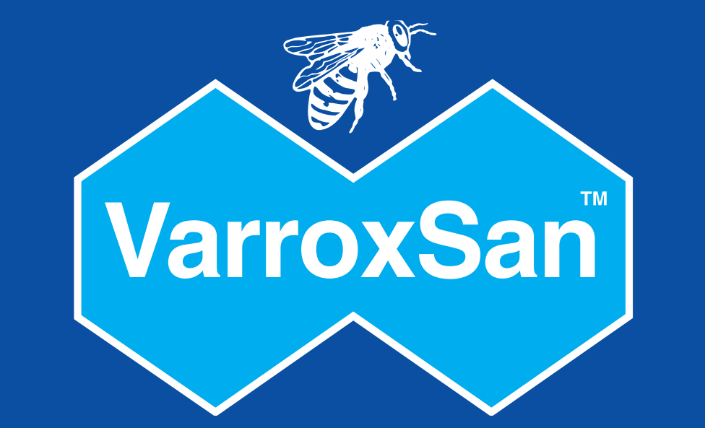



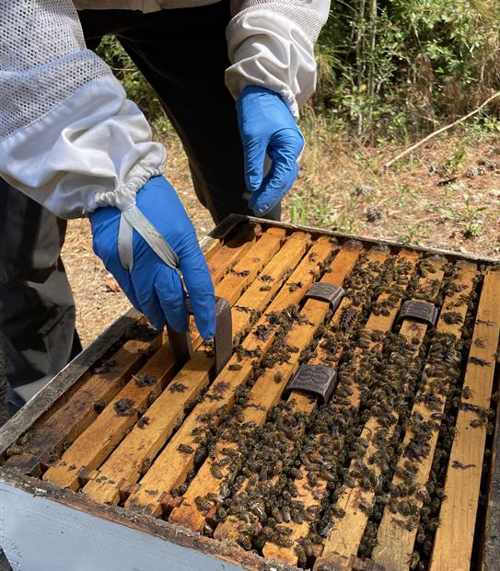
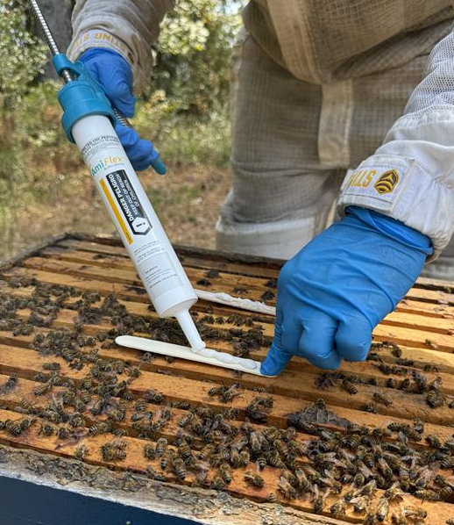
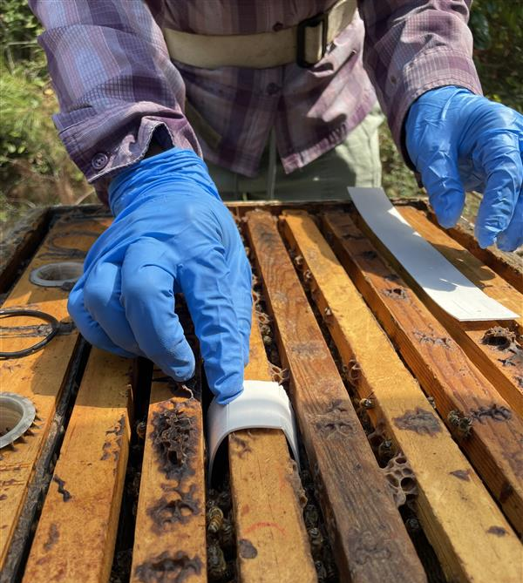
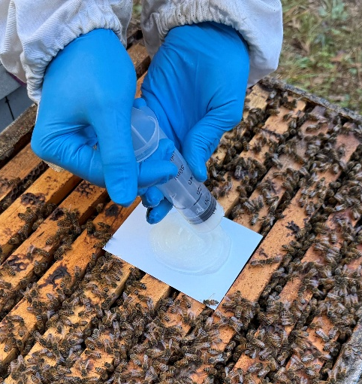



Comparison of new fall treatment programs for control of
Varroa destructor in managed honey bee colonies
Brandon Shannon, Ben DeMoras, Agostina Giacobino, Geoff Williams
Department of Entomology and Plant Pathology, Auburn University
Introduction
The beekeeping industry is threatened by record high colony losses¹, largely due to the ectoparasitic mite, Varroa destructor²
While treatment options for Varroa are limited, several new products have been recently registered
Proprietary thymol product
Oxalic acid strips
2024
Amitraz flash treatment
2024
Amitraz strips
2024
Currently undergoing registration
Experimental Design
Objective
Compare effects on colony strength and Varroa infestation for Fall treatment programs of newly-registered miticides to the industry standard, Apivar®
Fig 1. Timeline for each of the 5 Fall treatment programs, where Day 0 started on Sept. 22. A 15-day cleanup treatment to knock down Varroa remaining in colonies consisted of 3 successive applications of oxalic acid dribble.
Response Variables
Liebefeld assessments³ were used to assess colony strength by estimating % coverage of each frame for bees, capped brood, honey, and pollen
Alcohol washes⁴ of ~300 bees were used to assess infestation rate of Varroa on adult bees
Sticky boards⁴ were used to assess Varroa that fell beneath the colony over a period of 2-4 days, which we term “mite drop”
Results
Both VarroxSan groups had reduced quantity of adult bees compared to Apivar 2.0
VarroxSan→AmiFlex had significantly more Varroa than all groups at day 21 (Fig 2)
VarroxSan→AmiFlex had significantly lower mite drop efficacy over the first two weeks compared to Apivar 2.0, AmiFlex→Thymol, and AmiFlex→VarroxSan
Fig 2. Varroa infestation on adult bees, measured as Varroa per 100 bees, as determined by alcohol washes. Asterisks (*) indicate significant differences (p < 0.05) between treatments using a linear mixed model with Tukey post-hoc adjustment. Two VarroxSan→Amiflex colonies were removed on day 21 due to high mite levels, to avoid impacting other colonies.
Discussion
Apivar 2.0 provided effective mite control without compromising colony strength
Note: rotation is important to limit miticide resistance
VarroxSan alone has demonstrated mixed results in other studies⁵⁻⁷. We demonstrated that VarroxSan is not consistently effective when applied alone, but was more consistent following a flash treatment
Future work should compare different combinations of flash treatments combined with extended-release products
References (Link)
Funding
Notes:
Data available but not included: brood, honey, or pollen.
References as QR code?
Acknowledgements section for bee lab members and local beekeeper volunteers?

