Slide 1
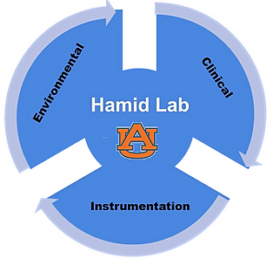

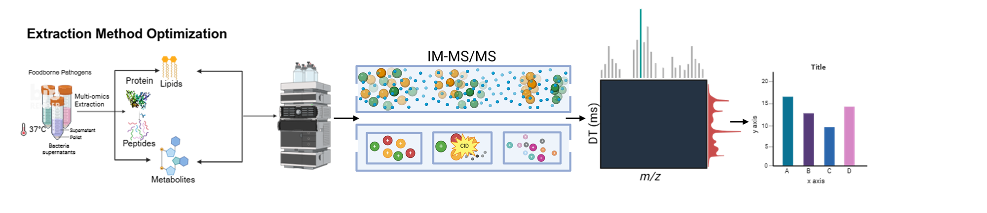
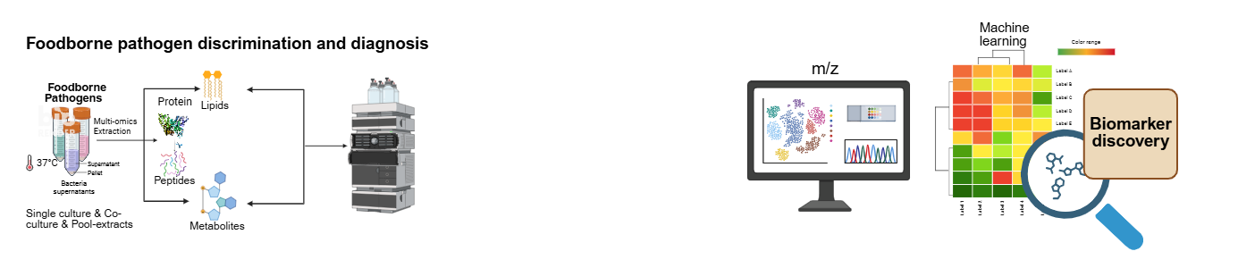
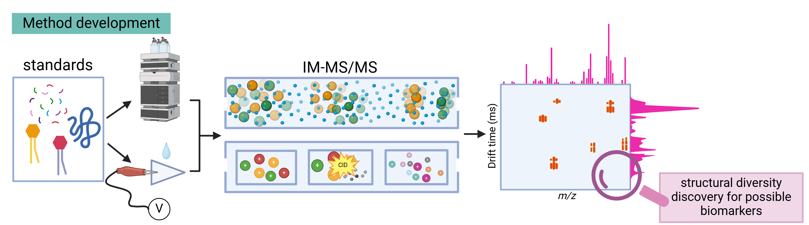
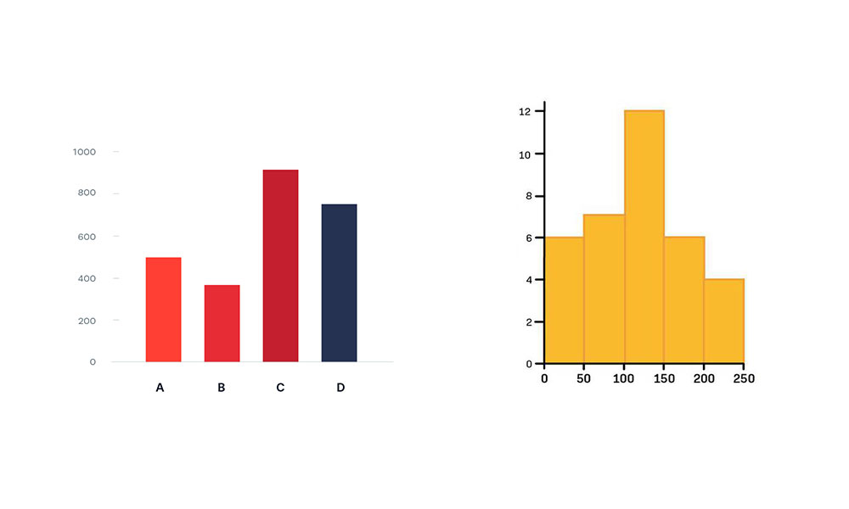



Comprehensive Discrimination of Foodborne Bacteria Using Whole-Omics Profiling by LC-IM-MS/MS in Combination with Machine Learning Algorithms
Adebowale S. Oyerinde, Iffat Jerin, Md Naymor Rahaman, and Ahmed M. Hamid^{PI}
Department of Chemistry and Biochemistry, Auburn University, 179 Chemistry Building, Auburn, AL 36849, United States
Introduction
Results: Lipidomic analysis
Experimental Results
Foodborne pathogens are a leading cause of gastrointestinal illness, posing significant public health risks and economic burdens¹.
Conventional microbiological methods are constrained by long turnaround times and limited discriminatory power, often delaying clinical decision-making and appropriate treatment.
Liquid chromatography coupled with ion mobility–tandem mass spectrometry (LC–IM–MS/MS) offers a four-dimensional platform capable of discriminating pathogens, including in mixed bacterial populations².
We develop an LC-IM-MS/MS–based whole-omics platform, integrated with machine learning, for accurate identification and discrimination of foodborne pathogens at the strain and sub-strain levels in single, co-culture, and mixed bacterial samples.
A.
B.
C.
D.
Experiment setup
A.
Figure 4. Ion mobility discrimination of bacterial pathogens using a shared PE lipid feature.
LC–IM–MS/MS analysis showed that all four foodborne pathogens (Salmonella typhimurium, Escherichia coli O157:H7, Campylobacter jejuni, and Listeria monocytogenes) contain the phosphatidylethanolamine lipid PE (30:1) at m/z 663.45. The lipid eluted at a single retention time and exhibited a conserved MS/MS fragmentation pattern across species. However, ion mobility (IM) separation revealed distinct mobility profiles: S. typhimurium and L. monocytogenes showed three IM peaks, whereas E. coli O157:H7 and C. jejuni displayed four IM peaks, enabling pathogen discrimination based on IM features.
E. Coli O157:H7
B.
Figure 3. LC-IM-MS/MS spectra acquired in positive ion mode for foodborne pathogens including five Escherichia coli strains, five Salmonella serovars, Listeria monocytogenes, and Campylobacter jejuni as well as their mixtures. MS spectra of single cultures, co-cultures, and pooled extracts demonstrate that each bacterium retains a distinct lipid fingerprint detectable within mixed samples.
Conclusion and Future work
Figure 1. (A) LC–IM–MS/MS–based multi-omics workflow integrating optimized extraction methods for lipidomics, proteomics, and metabolomics for accurate discrimination of bacterial strains in mixtures. (B) The platform profiles single cultures, co-cultures, and pooled foodborne bacteria to identify key lipid, protein, metabolite, and peptide biomarkers for strain identification.
References
Distinct lipid fingerprints remain detectable in mixed bacterial samples, demonstrating the robustness of the method.
Ion mobility (IM) separation reveals species-specific mobility patterns.
LC–IM–MS/MS provides a powerful platform for rapid discrimination and identification of foodborne pathogens in complex microbial populations.
Future Directions
Expand pathogen identification using metabolite, protein, and peptide fingerprints.
Integrate machine learning approaches to improve the accuracy and classification of bacterial pathogens.
1. Scallan, Elaine, et al. "Foodborne illness acquired in the United States—major pathogens." Emerging infectious diseases 17.1 (2011): 7.
2. Olajide, Orobola E., et al. "Discrimination of Common E. coli Strains in Urine by Liquid Chromatography–Ion Mobility–Tandem Mass Spectrometry and Machine Learning." Journal of the American Society for Mass Spectrometry 35.11 (2024): 2706-2713.
Figure 2. The Folch method provides the highest peak intensity and the broadest lipid identification.
Acknowledgement
1R35GM147225

