Slide 1


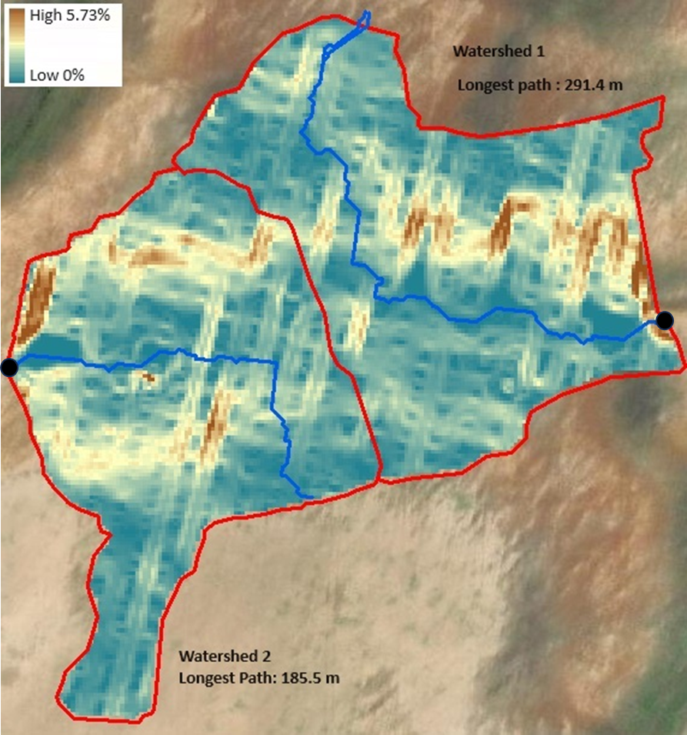
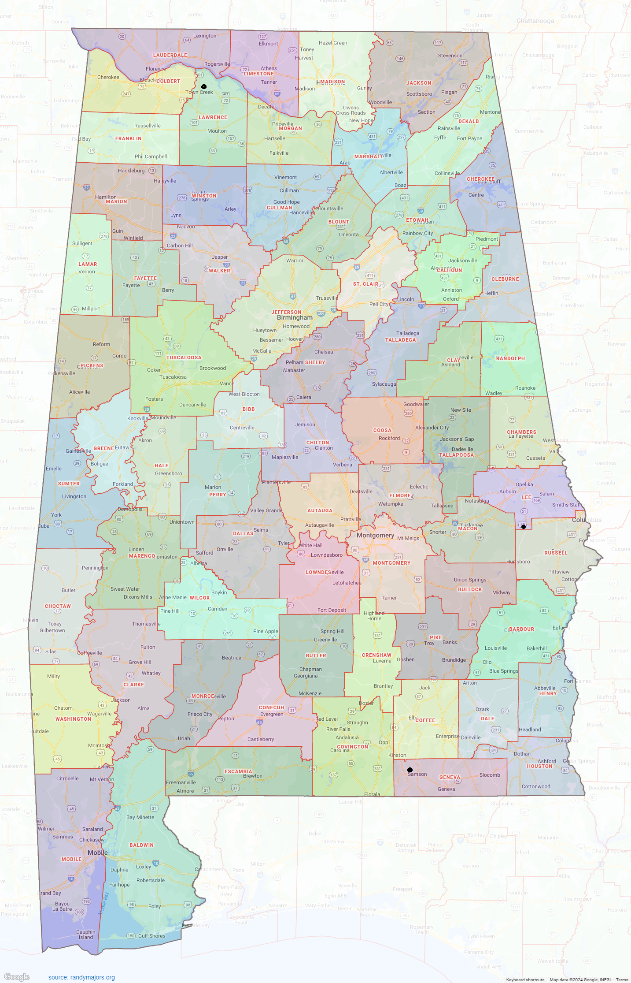
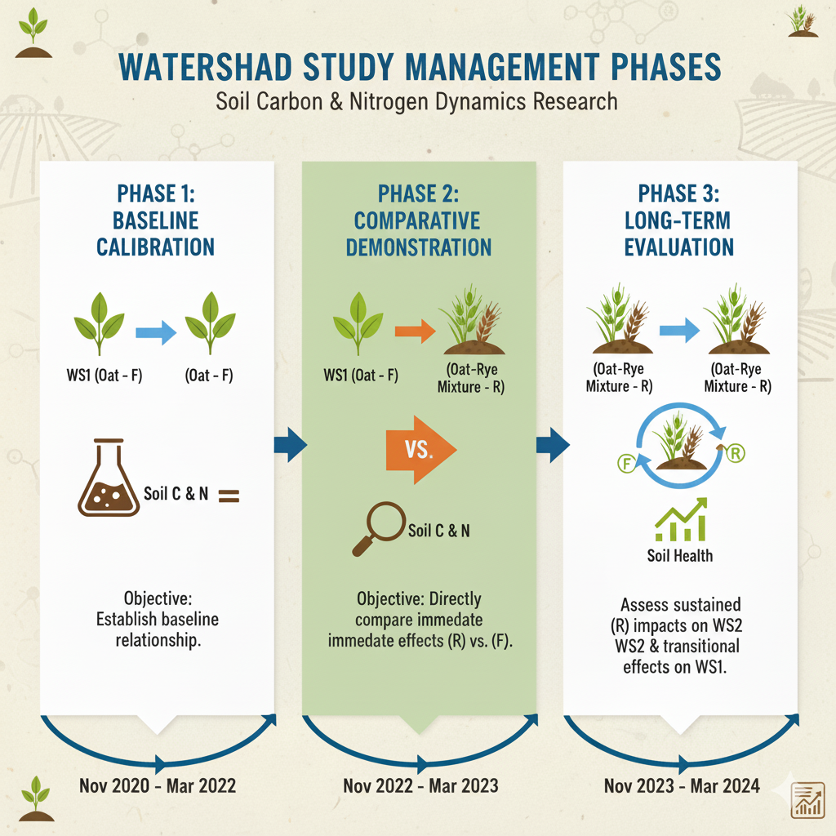
Soil Organic Carbon and Total Nitrogen Responses to Alternative Cover Crop Practices in Southeastern U.S. Peanut Rotations
Nguyen A.T., Prasad R
Crop, Soil and Environmental Sciences Department, Auburn University, USA
Introduction
Results
This study assesses strategies for improving soil health on sandy Southeastern U.S. soils by comparing two cover crop (CC) systems in Geneva County, Alabama. Over 4 years, a farmer practice oat CC (F) was evaluated against an Auburn University-recommended oat-rye mixture (R) within peanut rotations, measuring impacts on soil carbon (C) and nitrogen (N).
Hypothesis : The oat-rye mixture (R) will yield greater biomass and improve soil C and N compared to the farmer practice oat cover crop (F), due to enhanced belowground biomass and organic matter inputs.
Objective 1: Baseline Calibration
The two watersheds showed different baseline trends under the same farmer practice (F).
From 2021-2022, WS2 gained significant C and N, while WS1 lost both, highlighting inherent site differences.
Study design and Objectives
This study was conducted over three distinct phases to evaluate the impact of different cover crop strategies on soil health.
Objective 2: Comparative Demonstration (oat vs. mixture)
Geographic Location of the Study Field
In 2023, the recommended practice at WS2 showed a temporary drop in total C and N, likely because increased microbial activity led to accelerated C breakdown and N immobilization.
Conversely, the farmer practice (F) site showed a modest increase in both C and N during this period.
3.97 ha field.
Sandy loam.
Peanut – Corn – Cotton – Soybean
Objective 3: Evaluation
In 2nd year, the recommended practice (R) in WS2 showed sustained impact, accumulating nearly 10,000 kg/ha C and over 1,100 kg/ha N—the study's largest single-year gains.
Converting WS1 to recommended practice (R) in 2024 replicated WS2's initial temporary carbon dip but yielded an immediate, significant nitrogen gain of over 745 kg/ha.
Timeline of Study Phases and Interventions
Watershed 1 Watershed 2
Acknowledgement
Conclusions
The project was supported by Conservation Innovation Grant of NRCS.
Long-term monitoring is essential to correctly evaluate the impact of conservation practices.
The recommended oat-rye mixture appears to be an effective practice for initiating SOC and TN accretion, key indicators of soil health and fertility.

