Slide 1


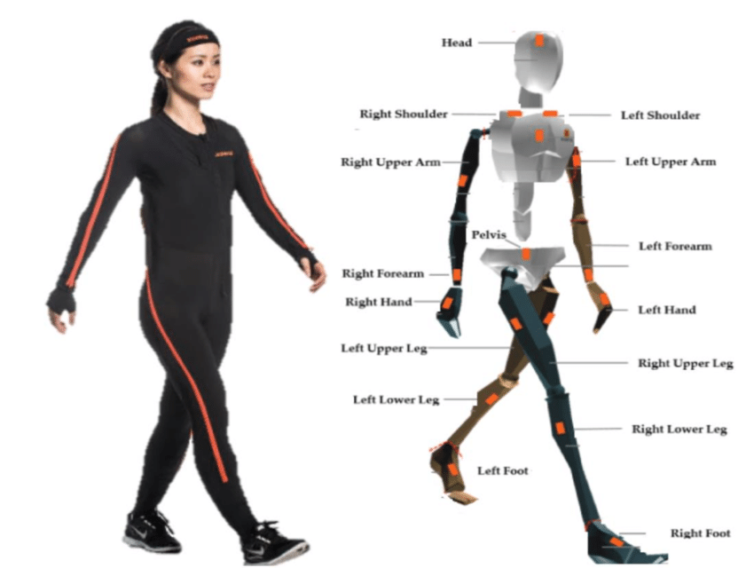

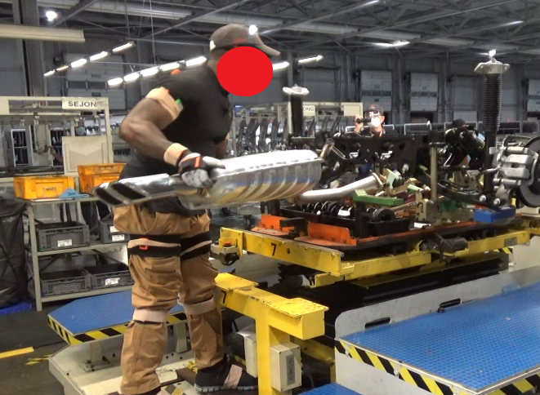
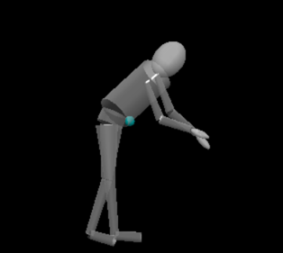
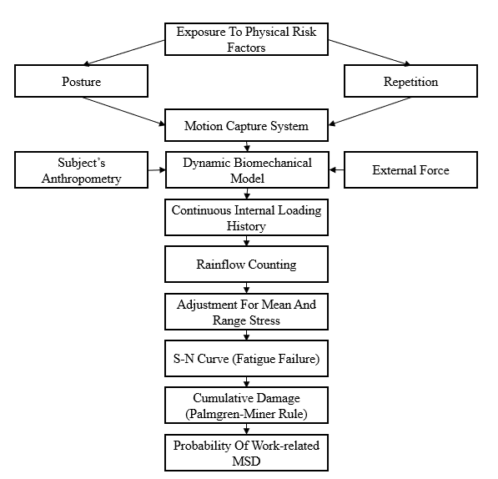
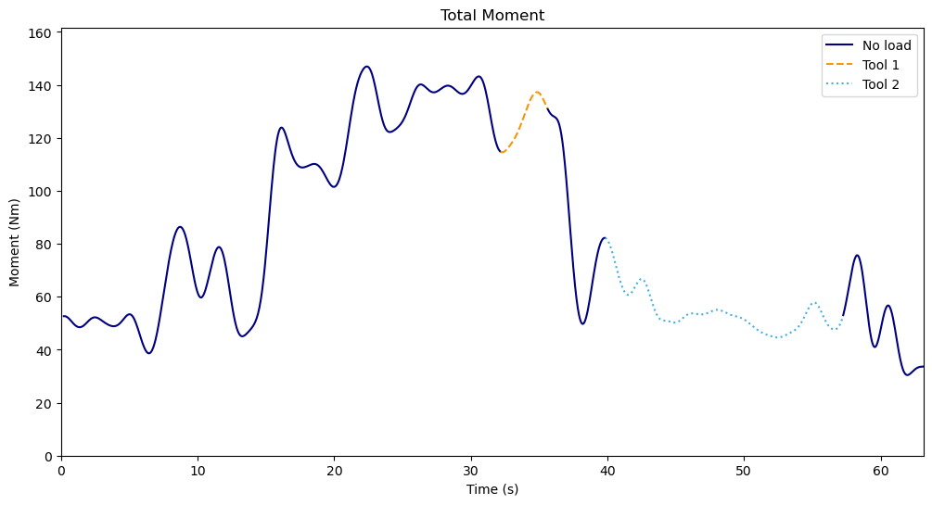
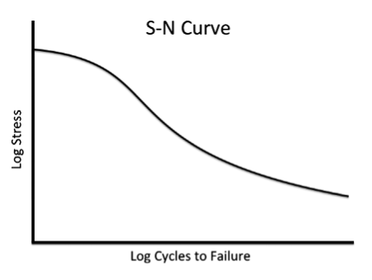
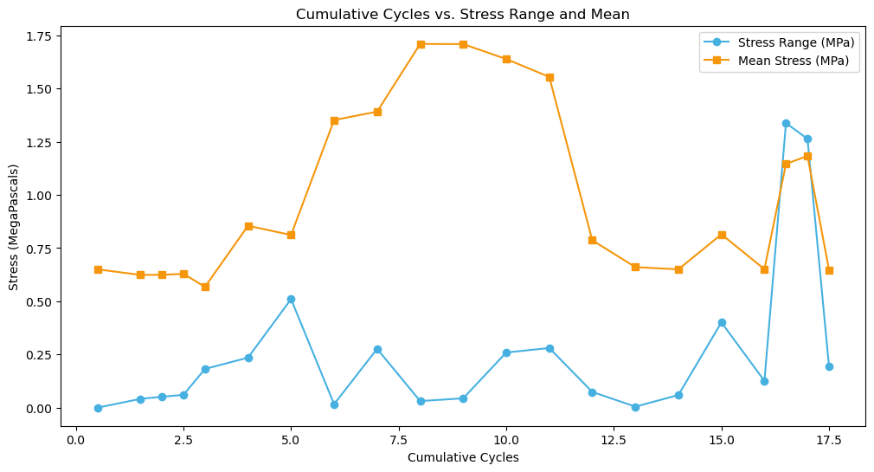

A Fatigue Failure Framework For The Assessment Of Highly Variable Low Back Loading Using Inertial Motion Capture – A Case Study
Nail-Ulloa I¹, Zabala M¹, Pool N², Sesek R², Thiese M³, Sesek R², Schall M², Gallagher S²
1 Mechanical Engineering Department, Auburn University
2 Industrial & Systems Engineering Department, Auburn University
3 Rocky Mountain Center for Occupational and Environmental Health, University of Utah
Scan To Watch an Experimental Trial!
INTRODUCTION
Mechanical loading of the spine has been identified as an important risk factor for low-back pain.
Workers in manufacturing settings experience highly variable musculoskeletal loading, which current risk assessment methods often fail to capture adequately.
Recent studies have summarized evidence supporting a material fatigue failure process in musculoskeletal tissues.
MATERIALS AND METHODS
A sample of six males and two females (mean age = 33.11 years, SD = 10.59) was recruited. 108 trials were captured for different car models and job stations.
The kinematic data necessary for the kinetic estimates were obtained using a wearable inertial motion capture (IMC) system.
Stepwise logistic regression was used to assess the relationship between self-reported low back injuries and cumulative damage (CD) estimate.
OBJECTIVE
To evaluate a fatigue failure-based framework for assessing low back injury risk due to cumulative lumbar loading in industrial settings using inertial measurement units (IMUs).
DATA PROCESSING FRAMEWORK
Fig 1. IMC system
Fig 2. Study took place at KMMG
NIOSH Limit for compression
Fig 4. Worker during a trial and the Biomechanical Model
Fig 5. Loading history of compressive force
Fig 7. Biomechanical and musculoskeletal models
Fig 3. Fatigue Failure Processing Framework
Fig 6. Adjusted Stress Cycles
RESULTS
DISCUSSION
First attempt to continuously assess CD using fatigue failure theory and IMC technology. Results are promising, OR = 2.16; 95% Confidence Interval: 1.30–3.57.
The model provides flexible assessment capabilities for one- or two-handed lifts, various postures, personalized estimates, and an objective assessment method with defined thresholds based on material science.
Resulting Stepwise Model
Variable | Coefficient | Std Error | Coef/SE | p
Constant | -4.95 | 1.22 | -4.07 | <0.001
CD | 0.77 | 0.26 | 3.00 | 0.002
Subject | 0.06 | 0.03 | 2.27 | 0.023
REFERENCES AND FUNDING
Nail-Ulloa, Iván, Michael Zabala, Nathan Pool, Robert Sesek, Matthew Thiese, Richard Sesek, Mark C. Schall Jr, and Sean Gallagher. 2026. “A Fatigue Failure Framework for the Assessment of Highly Variable Low Back Loading Using Inertial Motion Capture – a Case Study.” Ergonomics 69 (2): 292–308. doi:10.1080/00140139.2025.2460695.
This work was supported by research funding from the Centers for Disease Control and Prevention (CDC) / National Institute for Occupational Safety and Health (NIOSH, Grant Nº: R21OH011208-01-00) and through the Deep South Center for Occupational Health and Safety at the University of Alabama-Birmingham (UAB) and Auburn University (Grant # T42OH008436).

