Slide 1



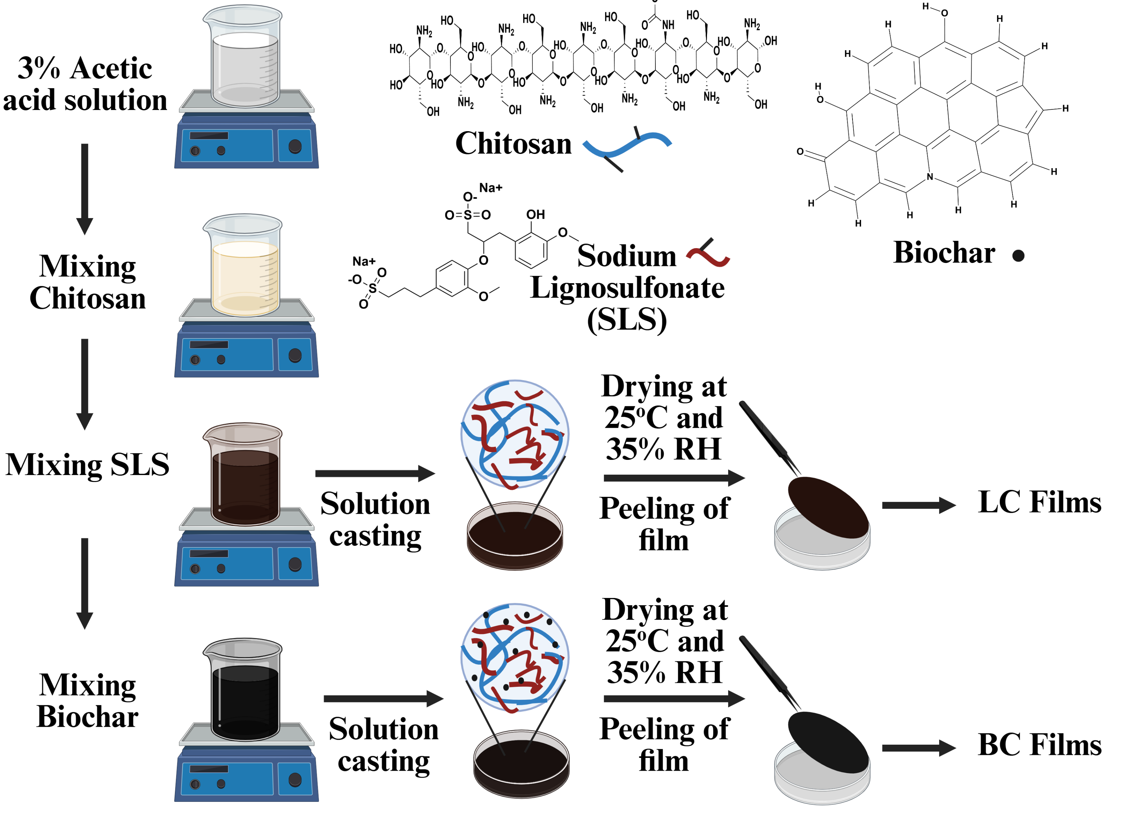
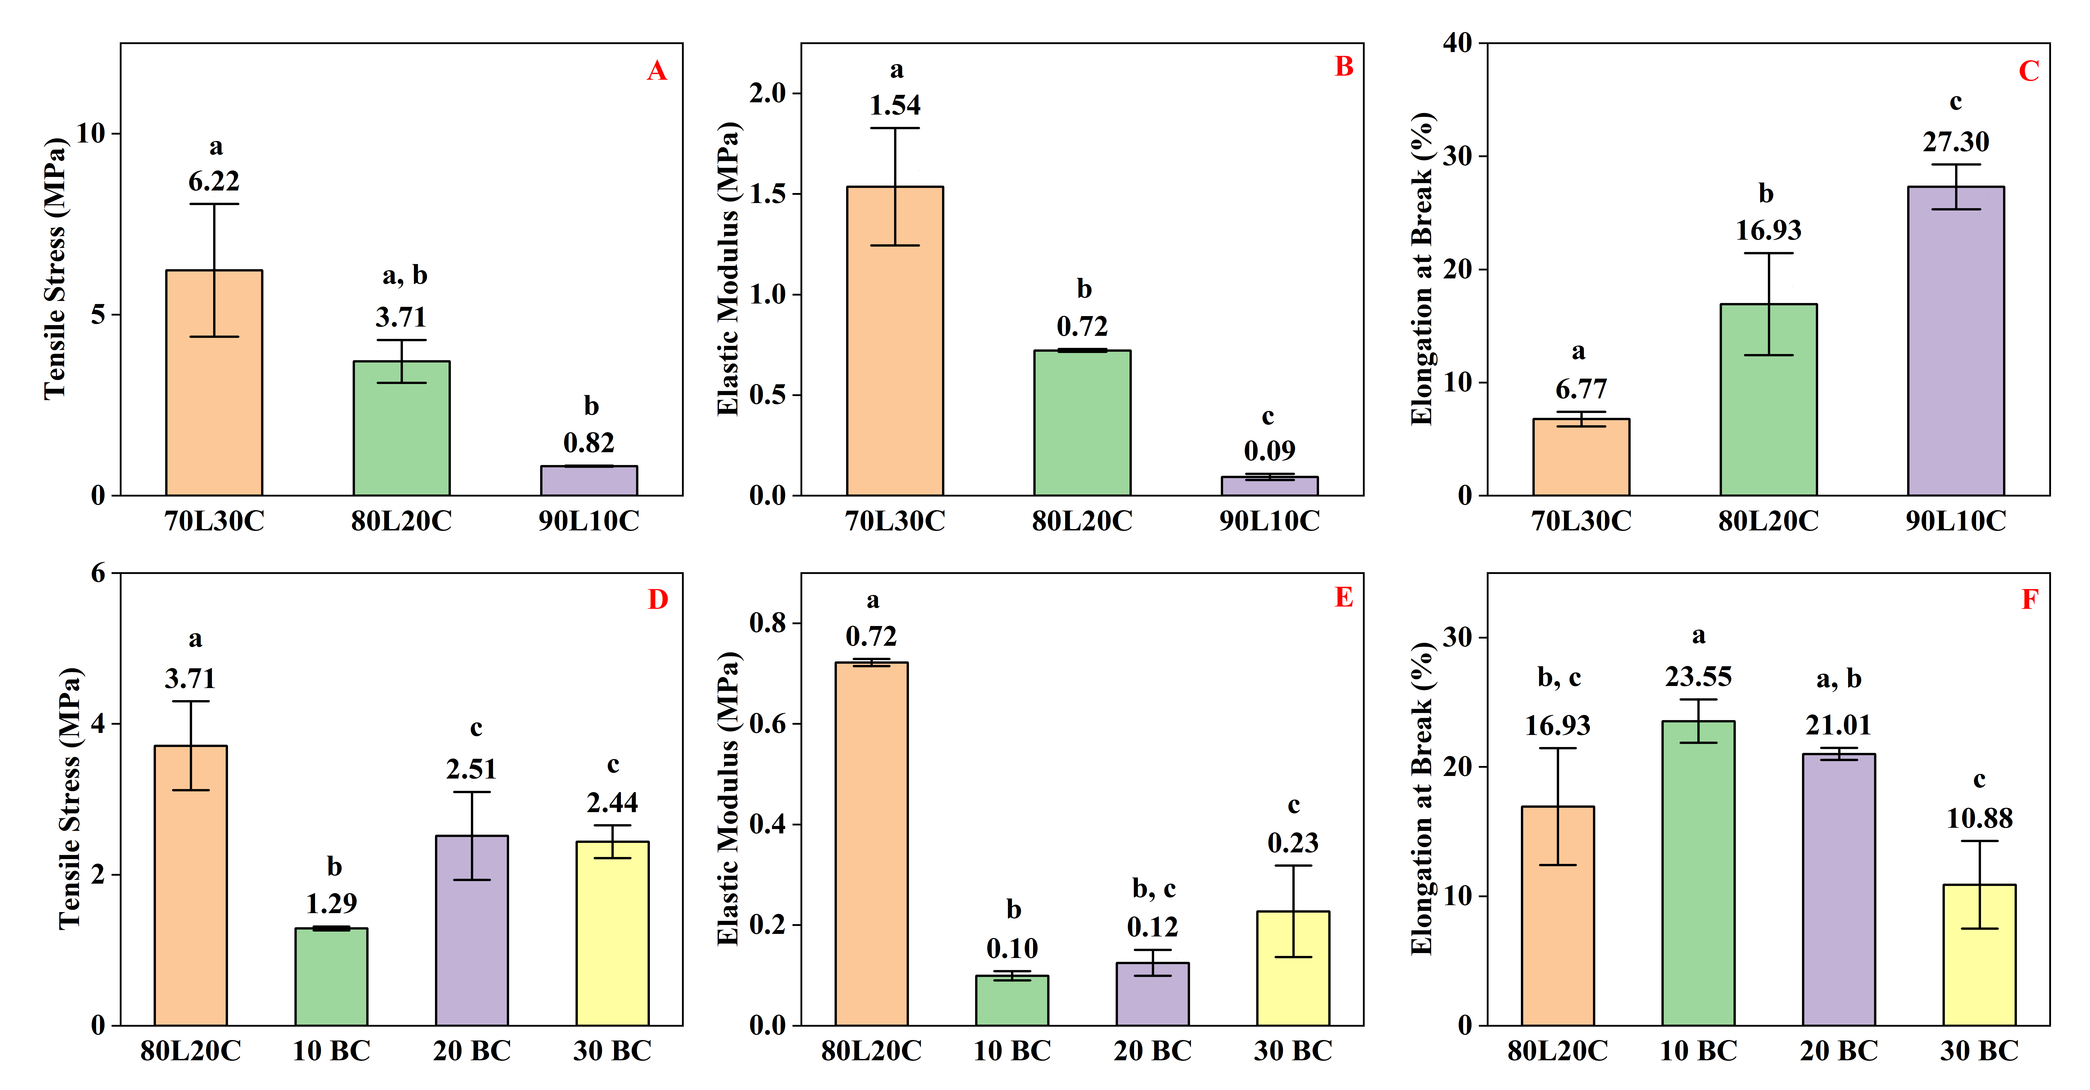
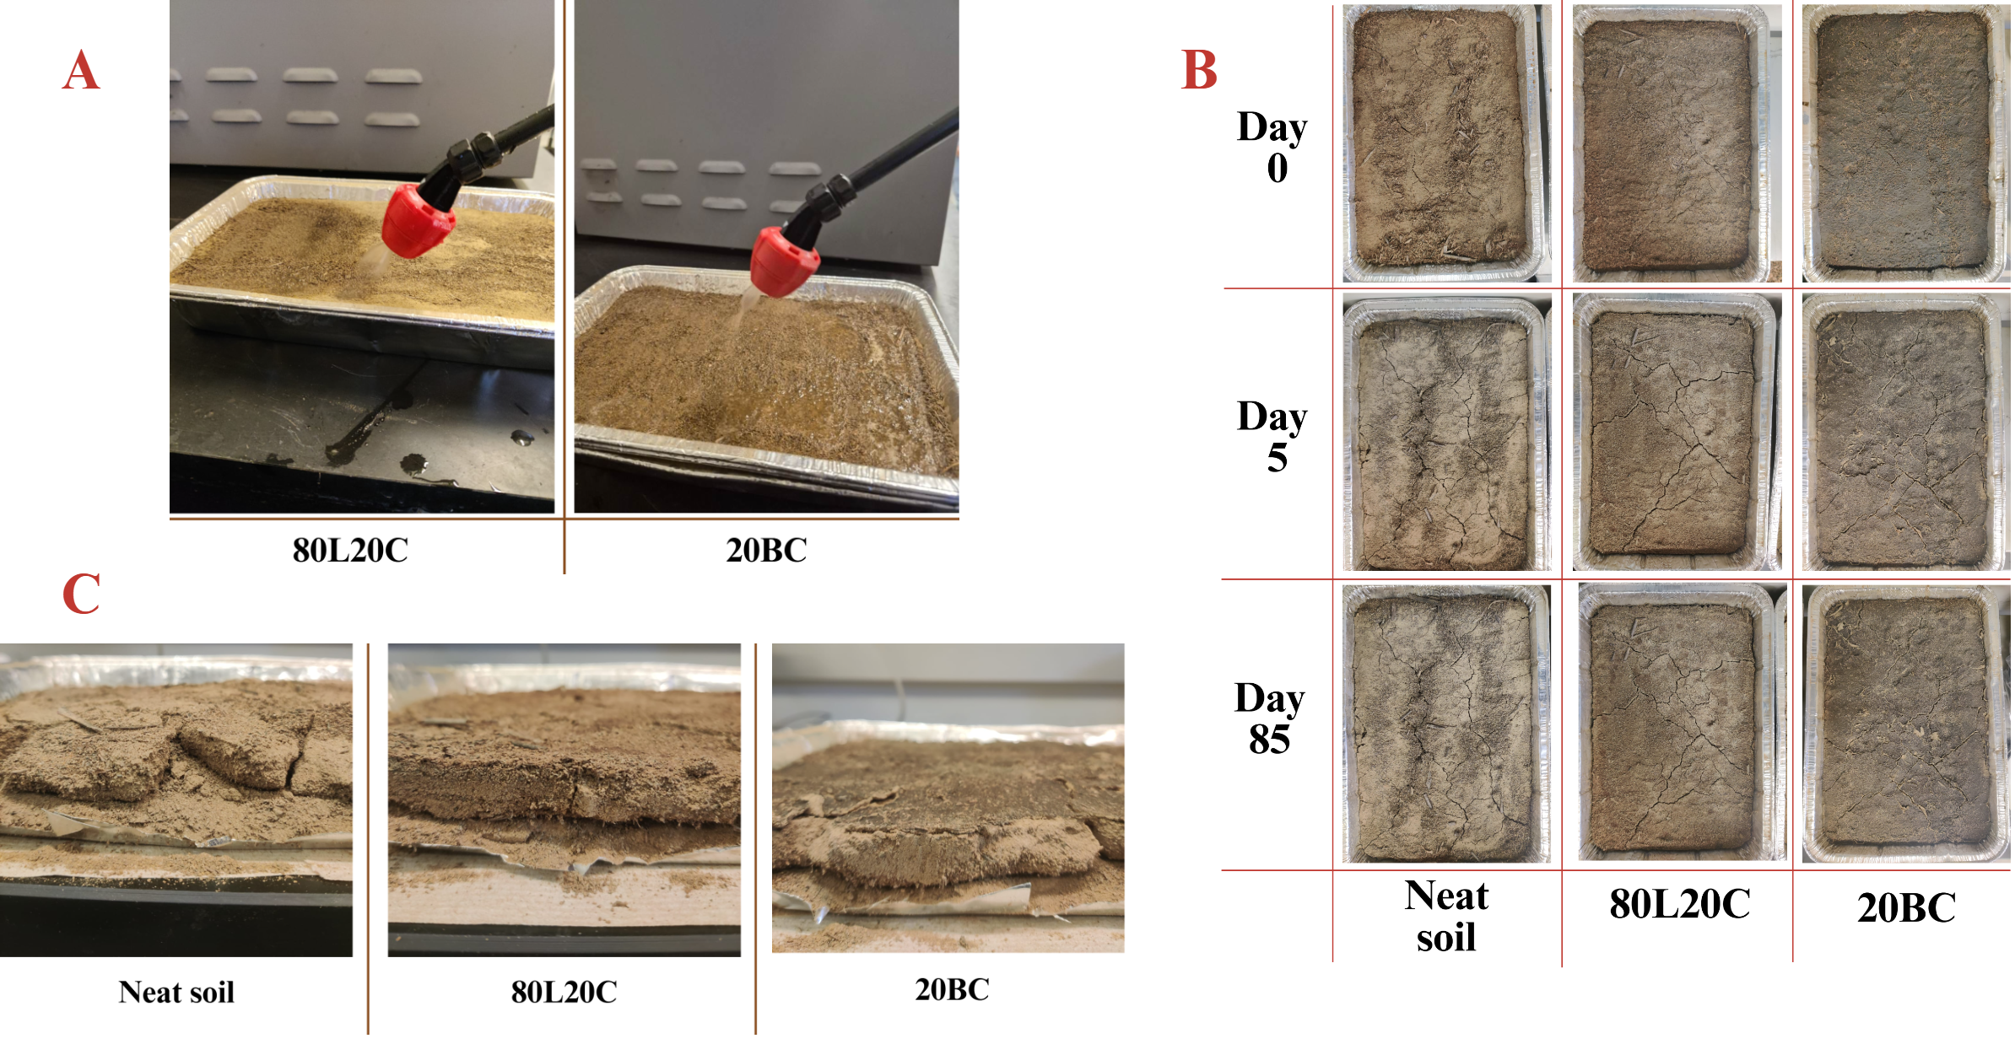
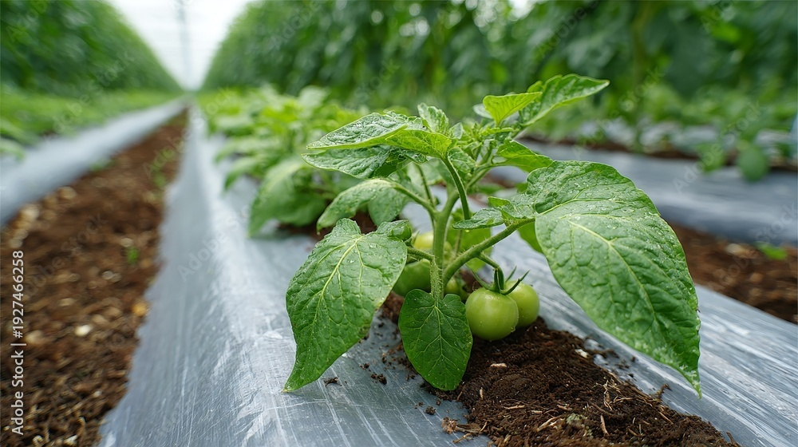
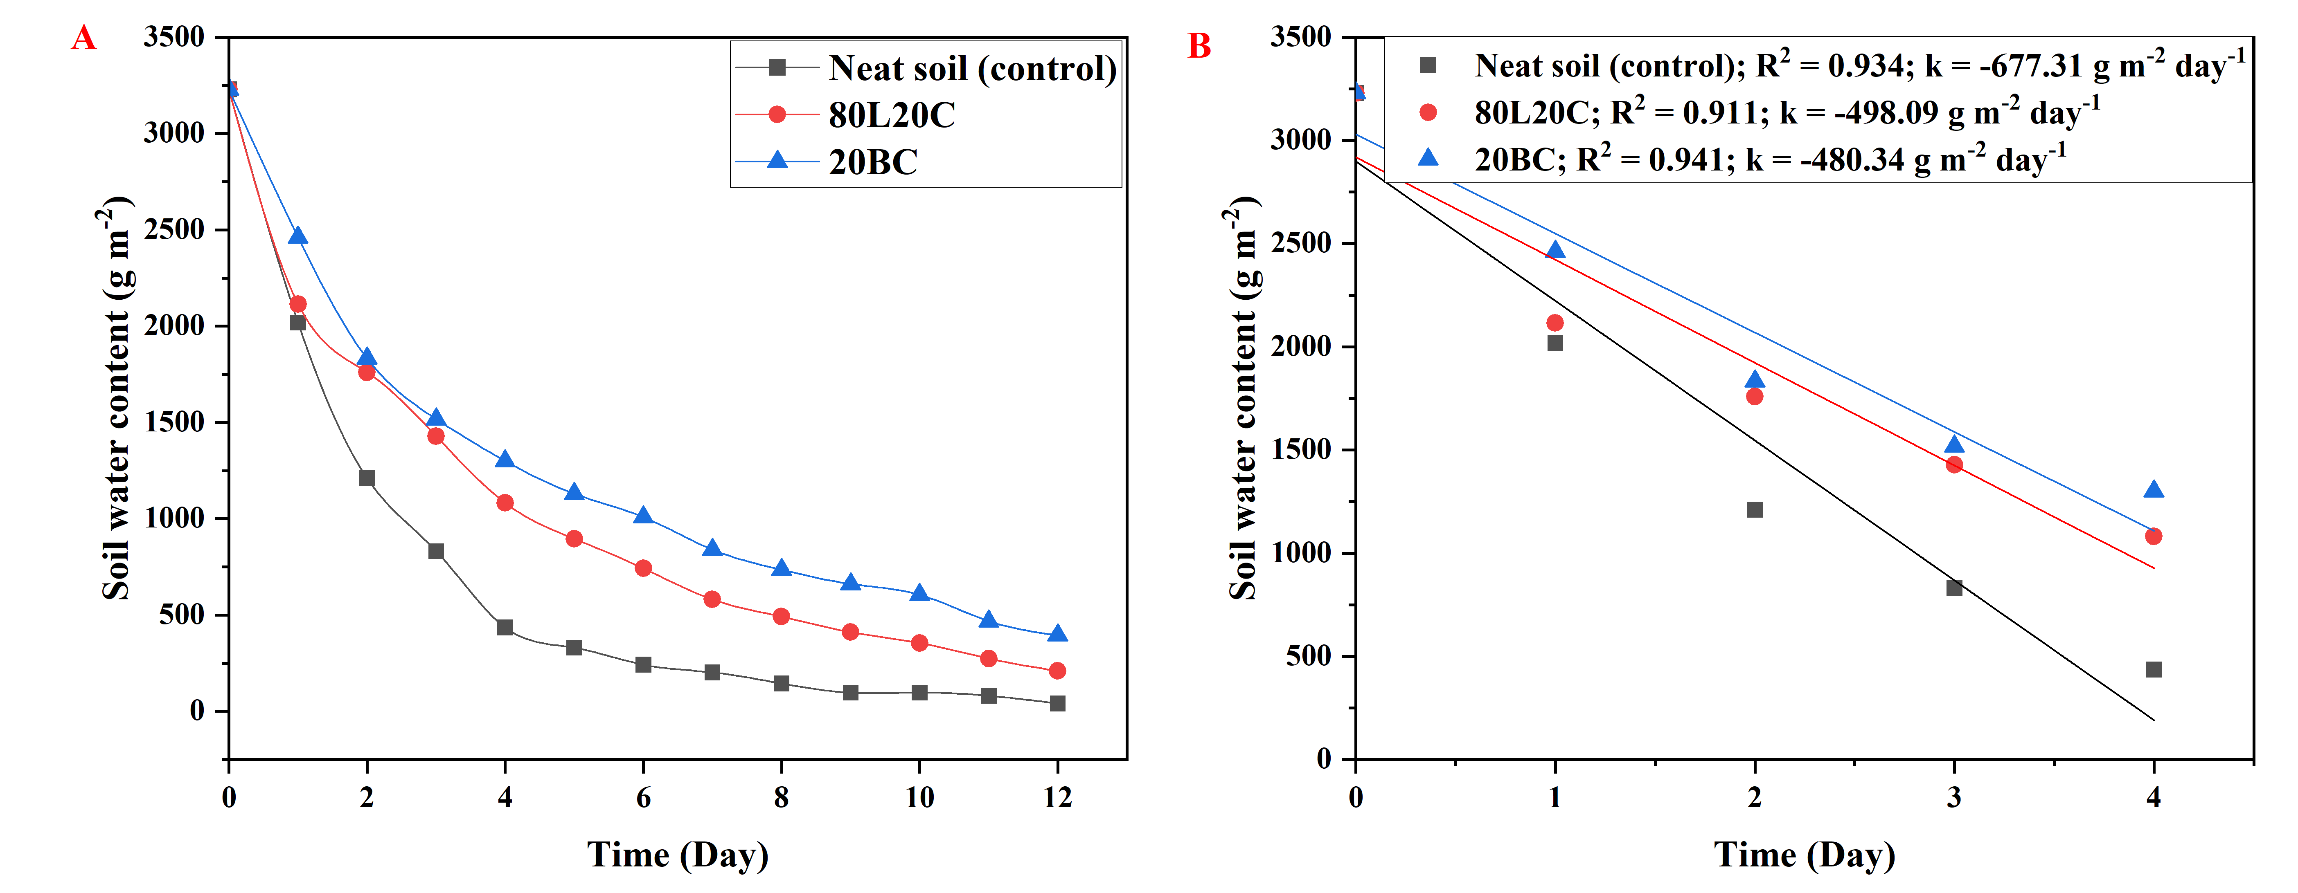
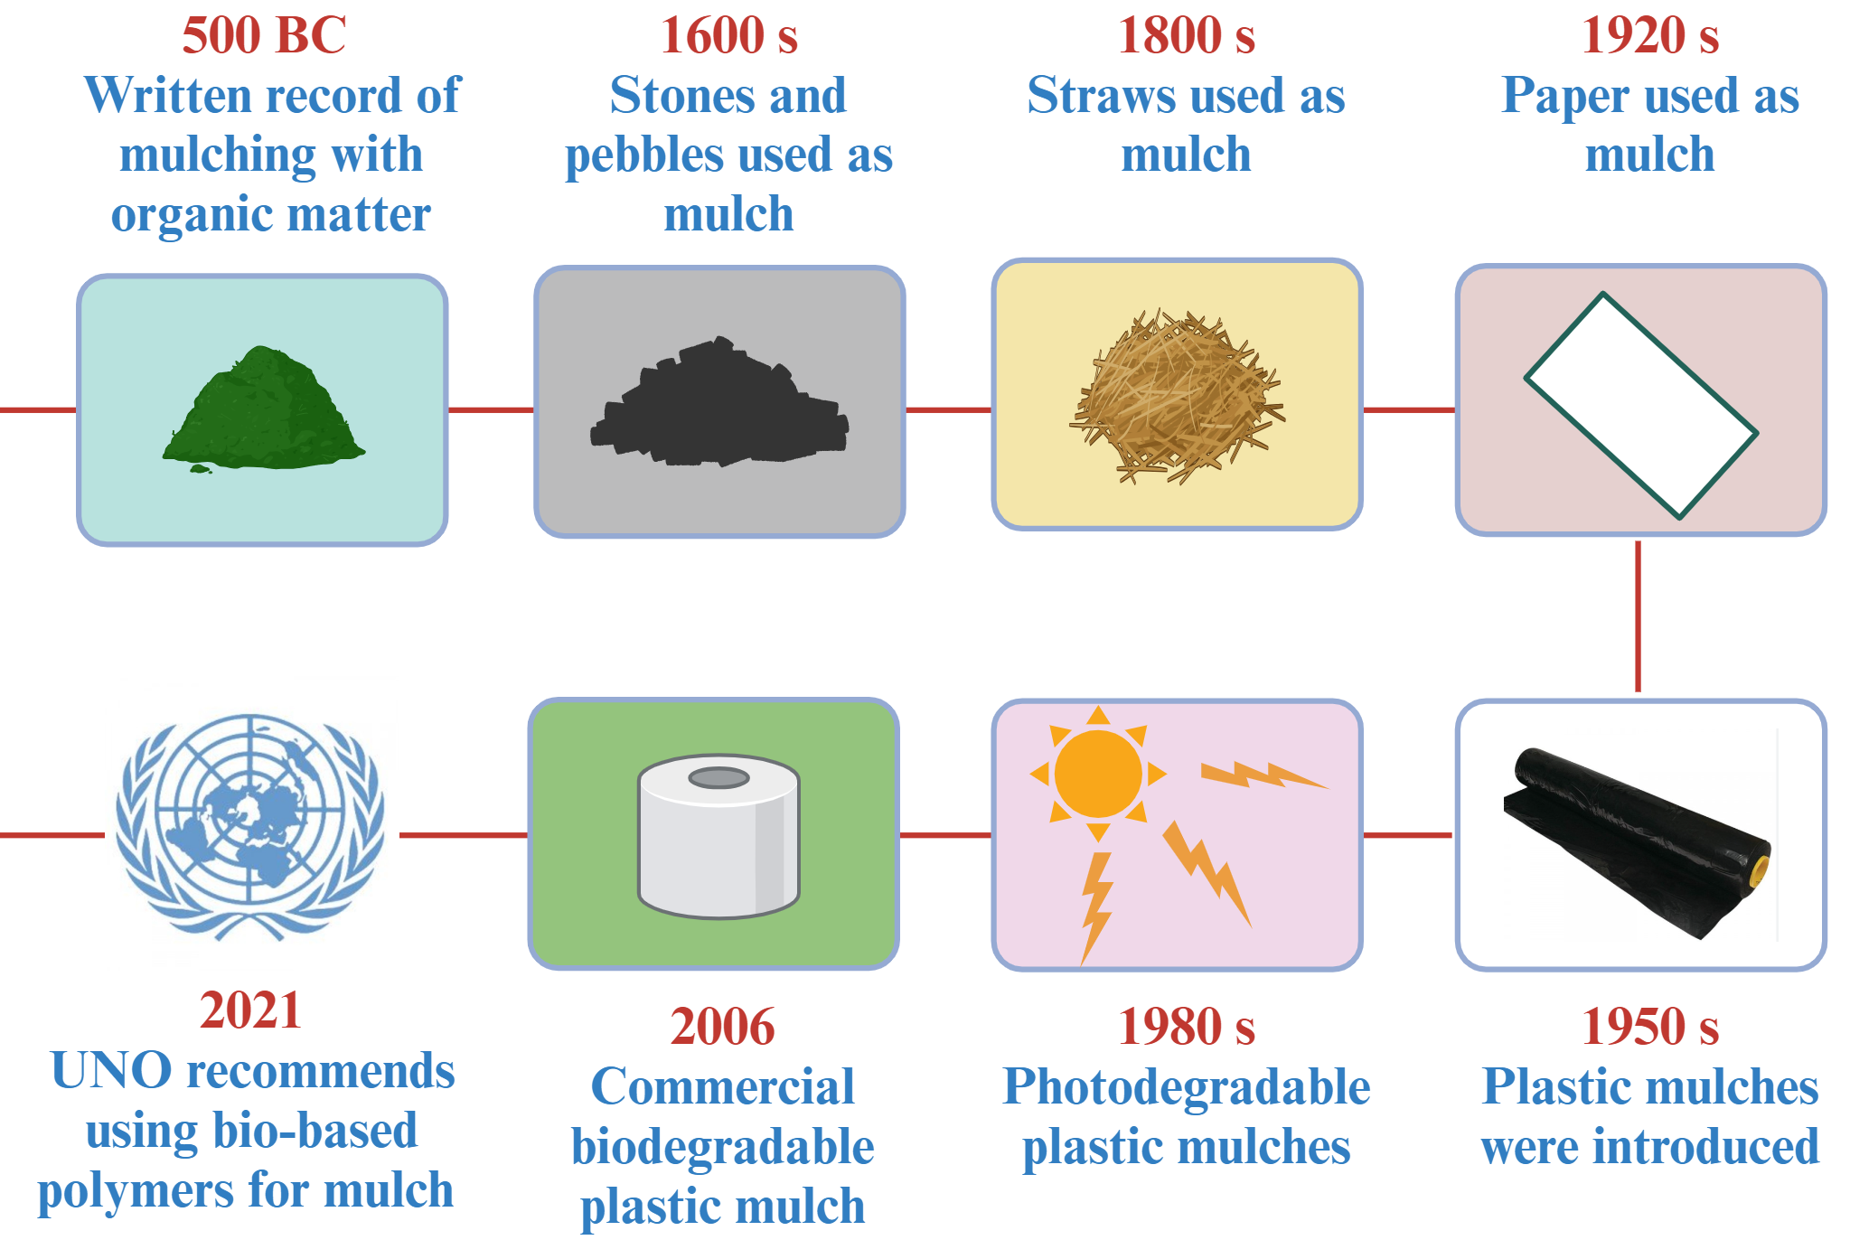
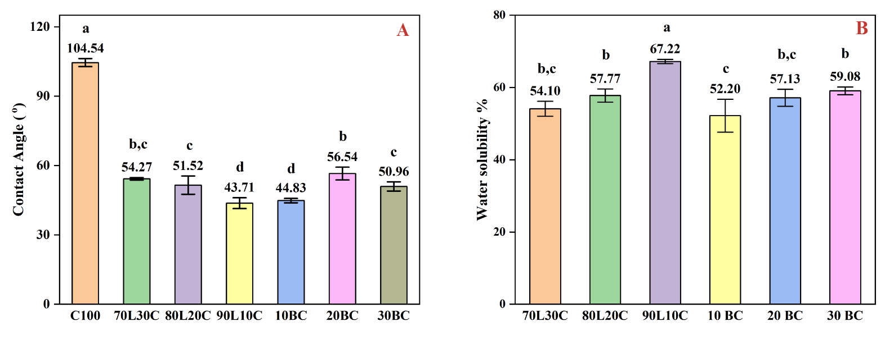
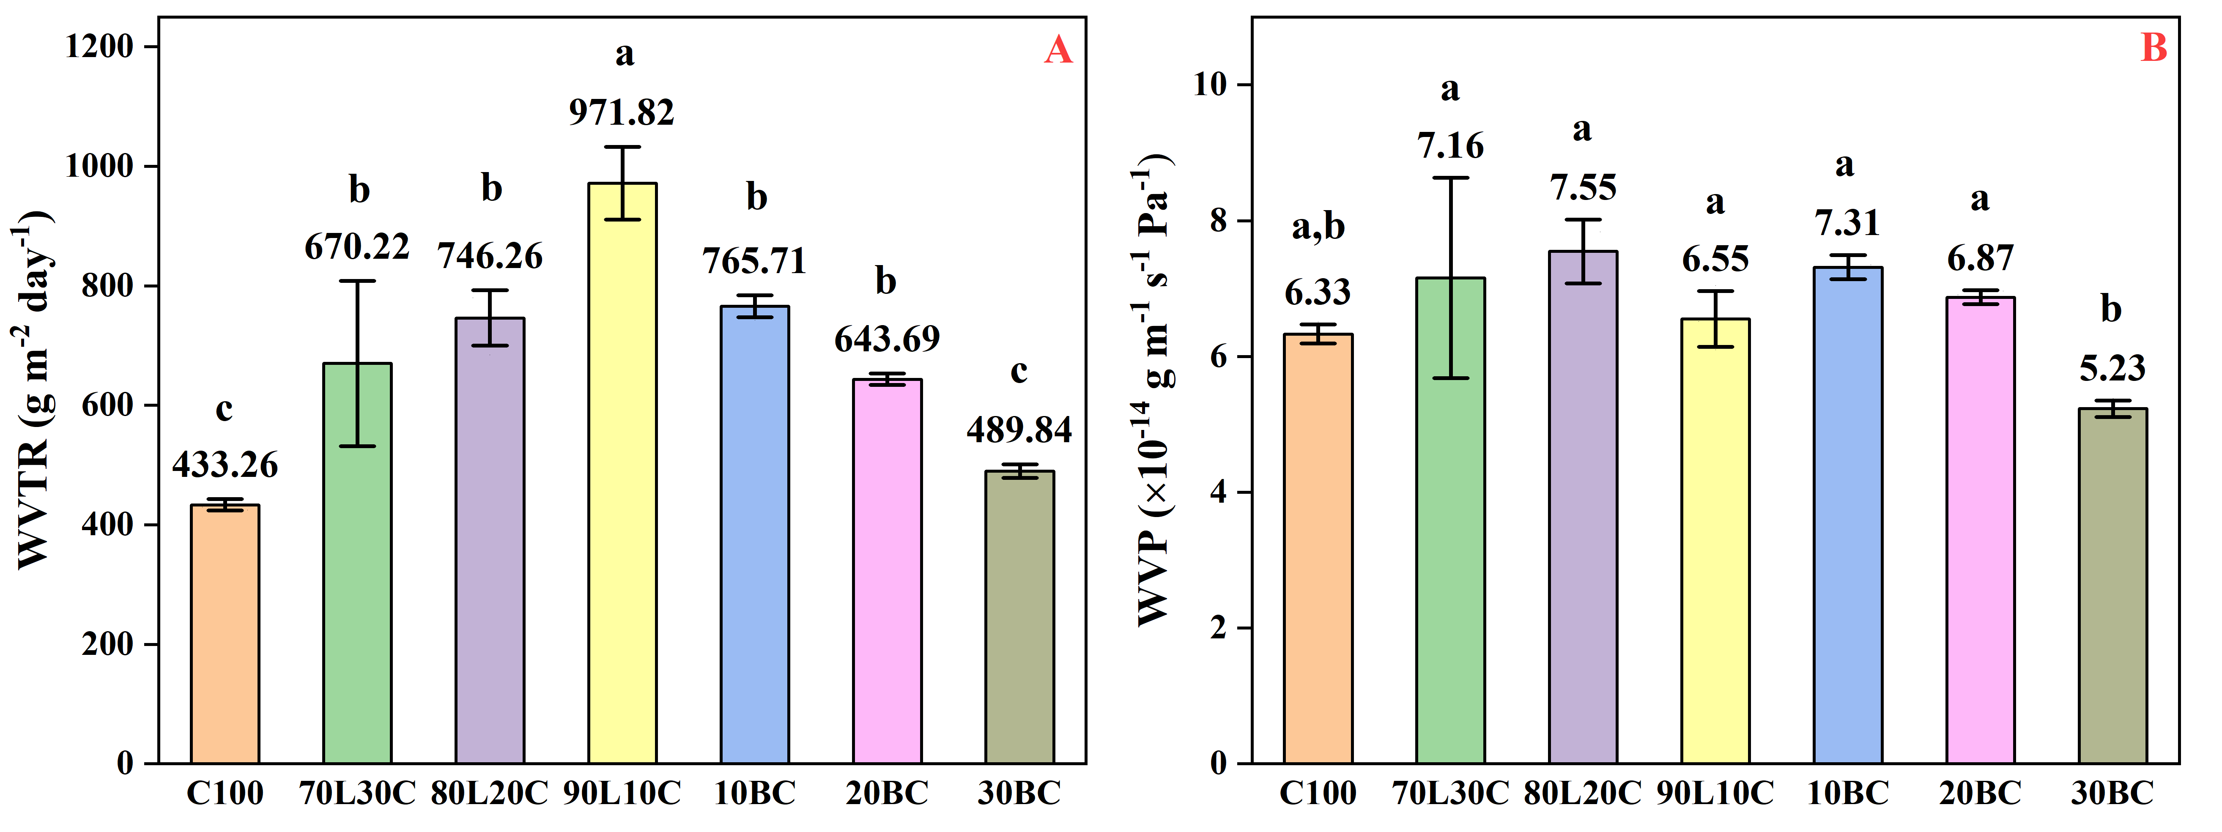
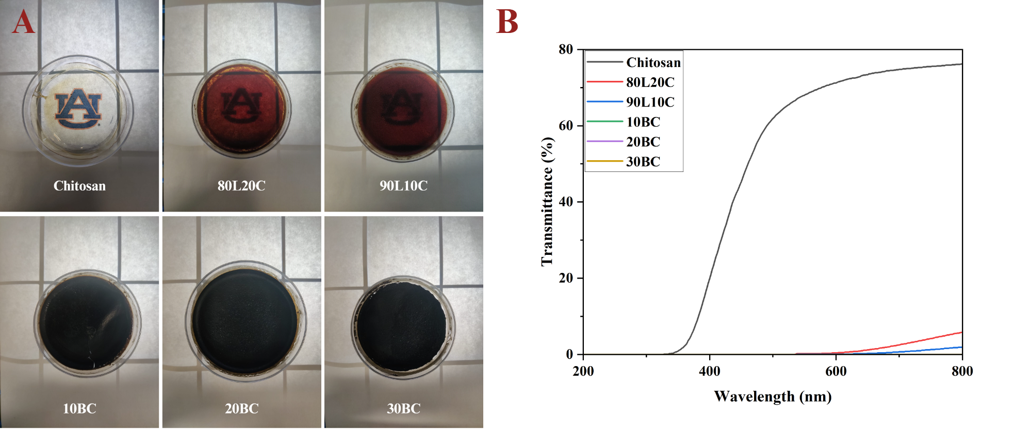
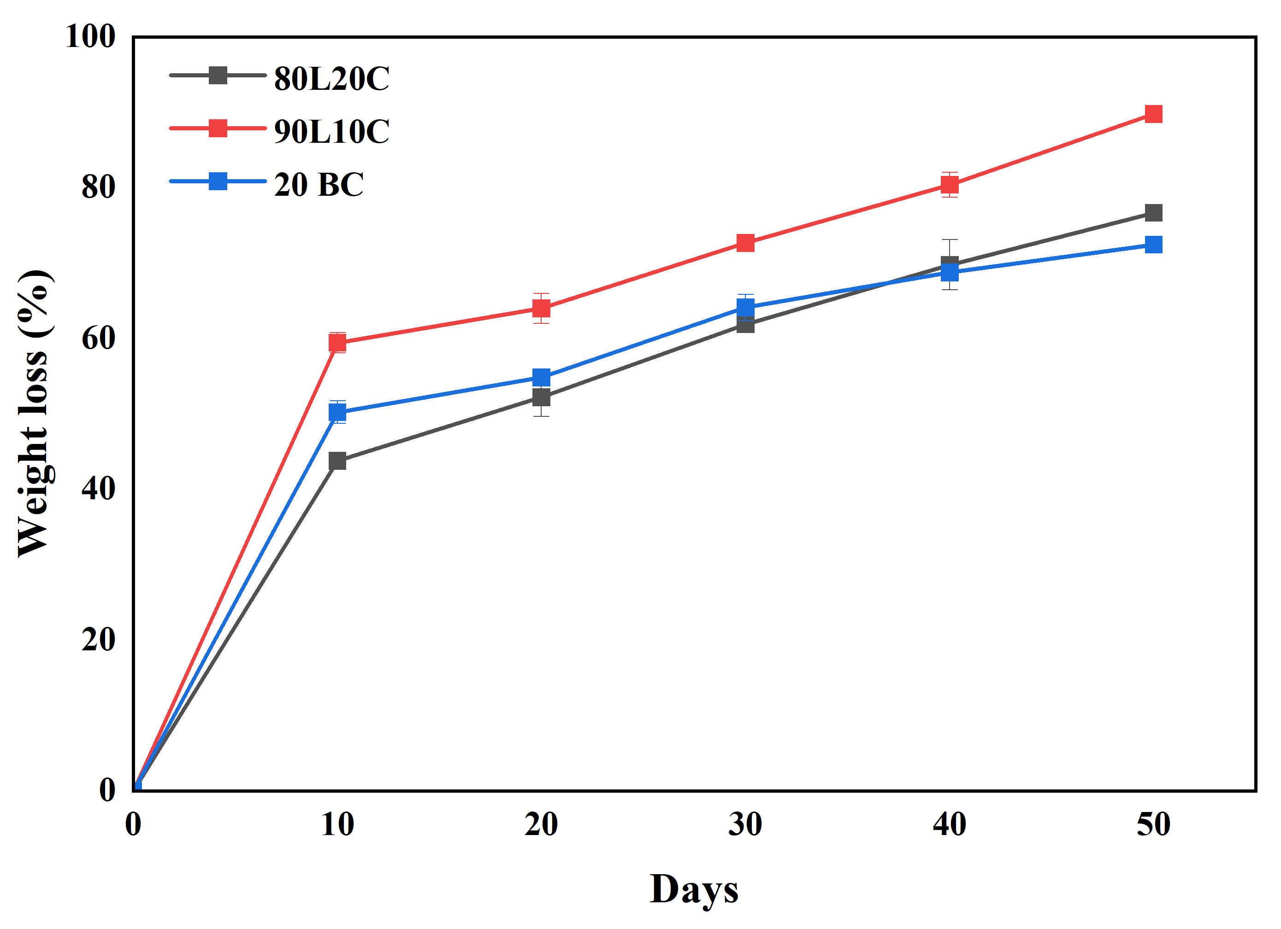

Development of biodegradable spray mulch from lignosulfonate, chitosan, and biochar towards sustainable agriculture
Nitesh Kumar Kasera¹, Sushil Adhikari^{1,2}, Hossein Jahromi¹
¹ Department of Biosystems Engineering, Auburn University, Auburn, AL 36849
² Center for Bioenergy and Bioproducts, Auburn University, Auburn, AL 36849
Introduction
Materials and Methods
Results
Results
What is mulch?
Mulch preparation
Mulch properties
Mulch performance
Protective layer on top-soil
Enables farmers to curtail the effects of drought, water loss, and soil erosion on crop production
Mechanical properties:
Sprayability and moisture retention:
History of mulch ª
Surface and barrier properties:
Sample name and composition
Sample Name | L weight % | C weight % | BC weight % w.r.t. L
L100 | 100 | 0 | 0
C100 | 0 | 100 | 0
70L30C | 70 | 30 | 0
80L20C | 80 | 20 | 0
90L10C | 90 | 10 | 0
10BC | 80 (74.07) | 20 (18.52) | 10 (7.40)
20BC | 80 (68.97) | 20 (17.24) | 20 (13.79)
30BC | 80 (64.52) | 20 (16.13) | 30 (19.35)
L: Sodium Lignosulfonate, C: Chitosan, BC: Biochar; Overall weight % in parentheses
Photochemical stability:
Sample | Exposure Time (h) | Carbonyl Index (CI) | Increase in CI (%)
80L20C | 0 | 1.304 ± 0.25 | -
 | 4 | 1.624 ± 0.09 | 24.54
 | 8 | 1.740 ± 0.03 | 33.43
20BC | 0 | 1.524 ± 0.04 | -
 | 4 | 1.580 ± 0.13 | 3.67
 | 8 | 1.638 ± 0.06 | 7.48
Problem and solution
Metrics | Plastic mulch | Bio-based mulch
Feedstock | Fossil-based | Renewable
Processing | 160 – 220 º C | < 40 º C
Application | Film laying | Spray applied
Retrieval | Needed | Not needed
Biodegradation | No | Yes
Soil health | Deteriorates | Improves
Optical properties:
Biodegradability:
Performance testing
Characterization – Mechanical, Optical, Barrier, Thermal, Physicochemical
Performance evaluation – Sprayability, UV blocking, Moisture retention in soil
The mulch photos in the first section of the Introduction are taken from Adobe Stock images, licensed by Auburn University
ª Image is modified from Mansoor et al. (2022); Polymers Use as Mulch Films in Agriculture—A Review of History, Problems and Current Trends, Polymers, 2022, 14(23), 5062
The work was funded by the Alabama Agricultural Experiment Station at Auburn University through AgRSEED Program

