Slide 1



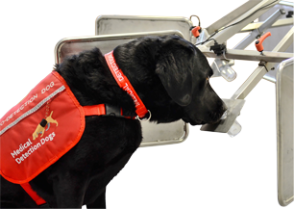
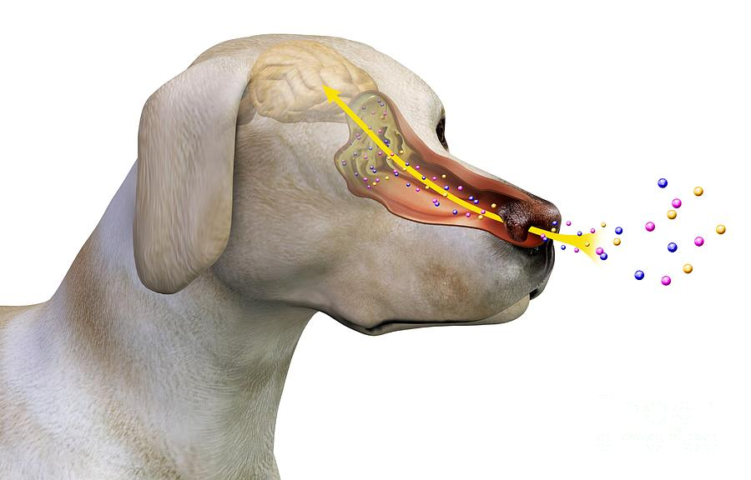
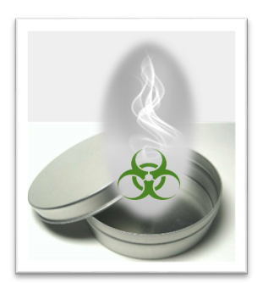

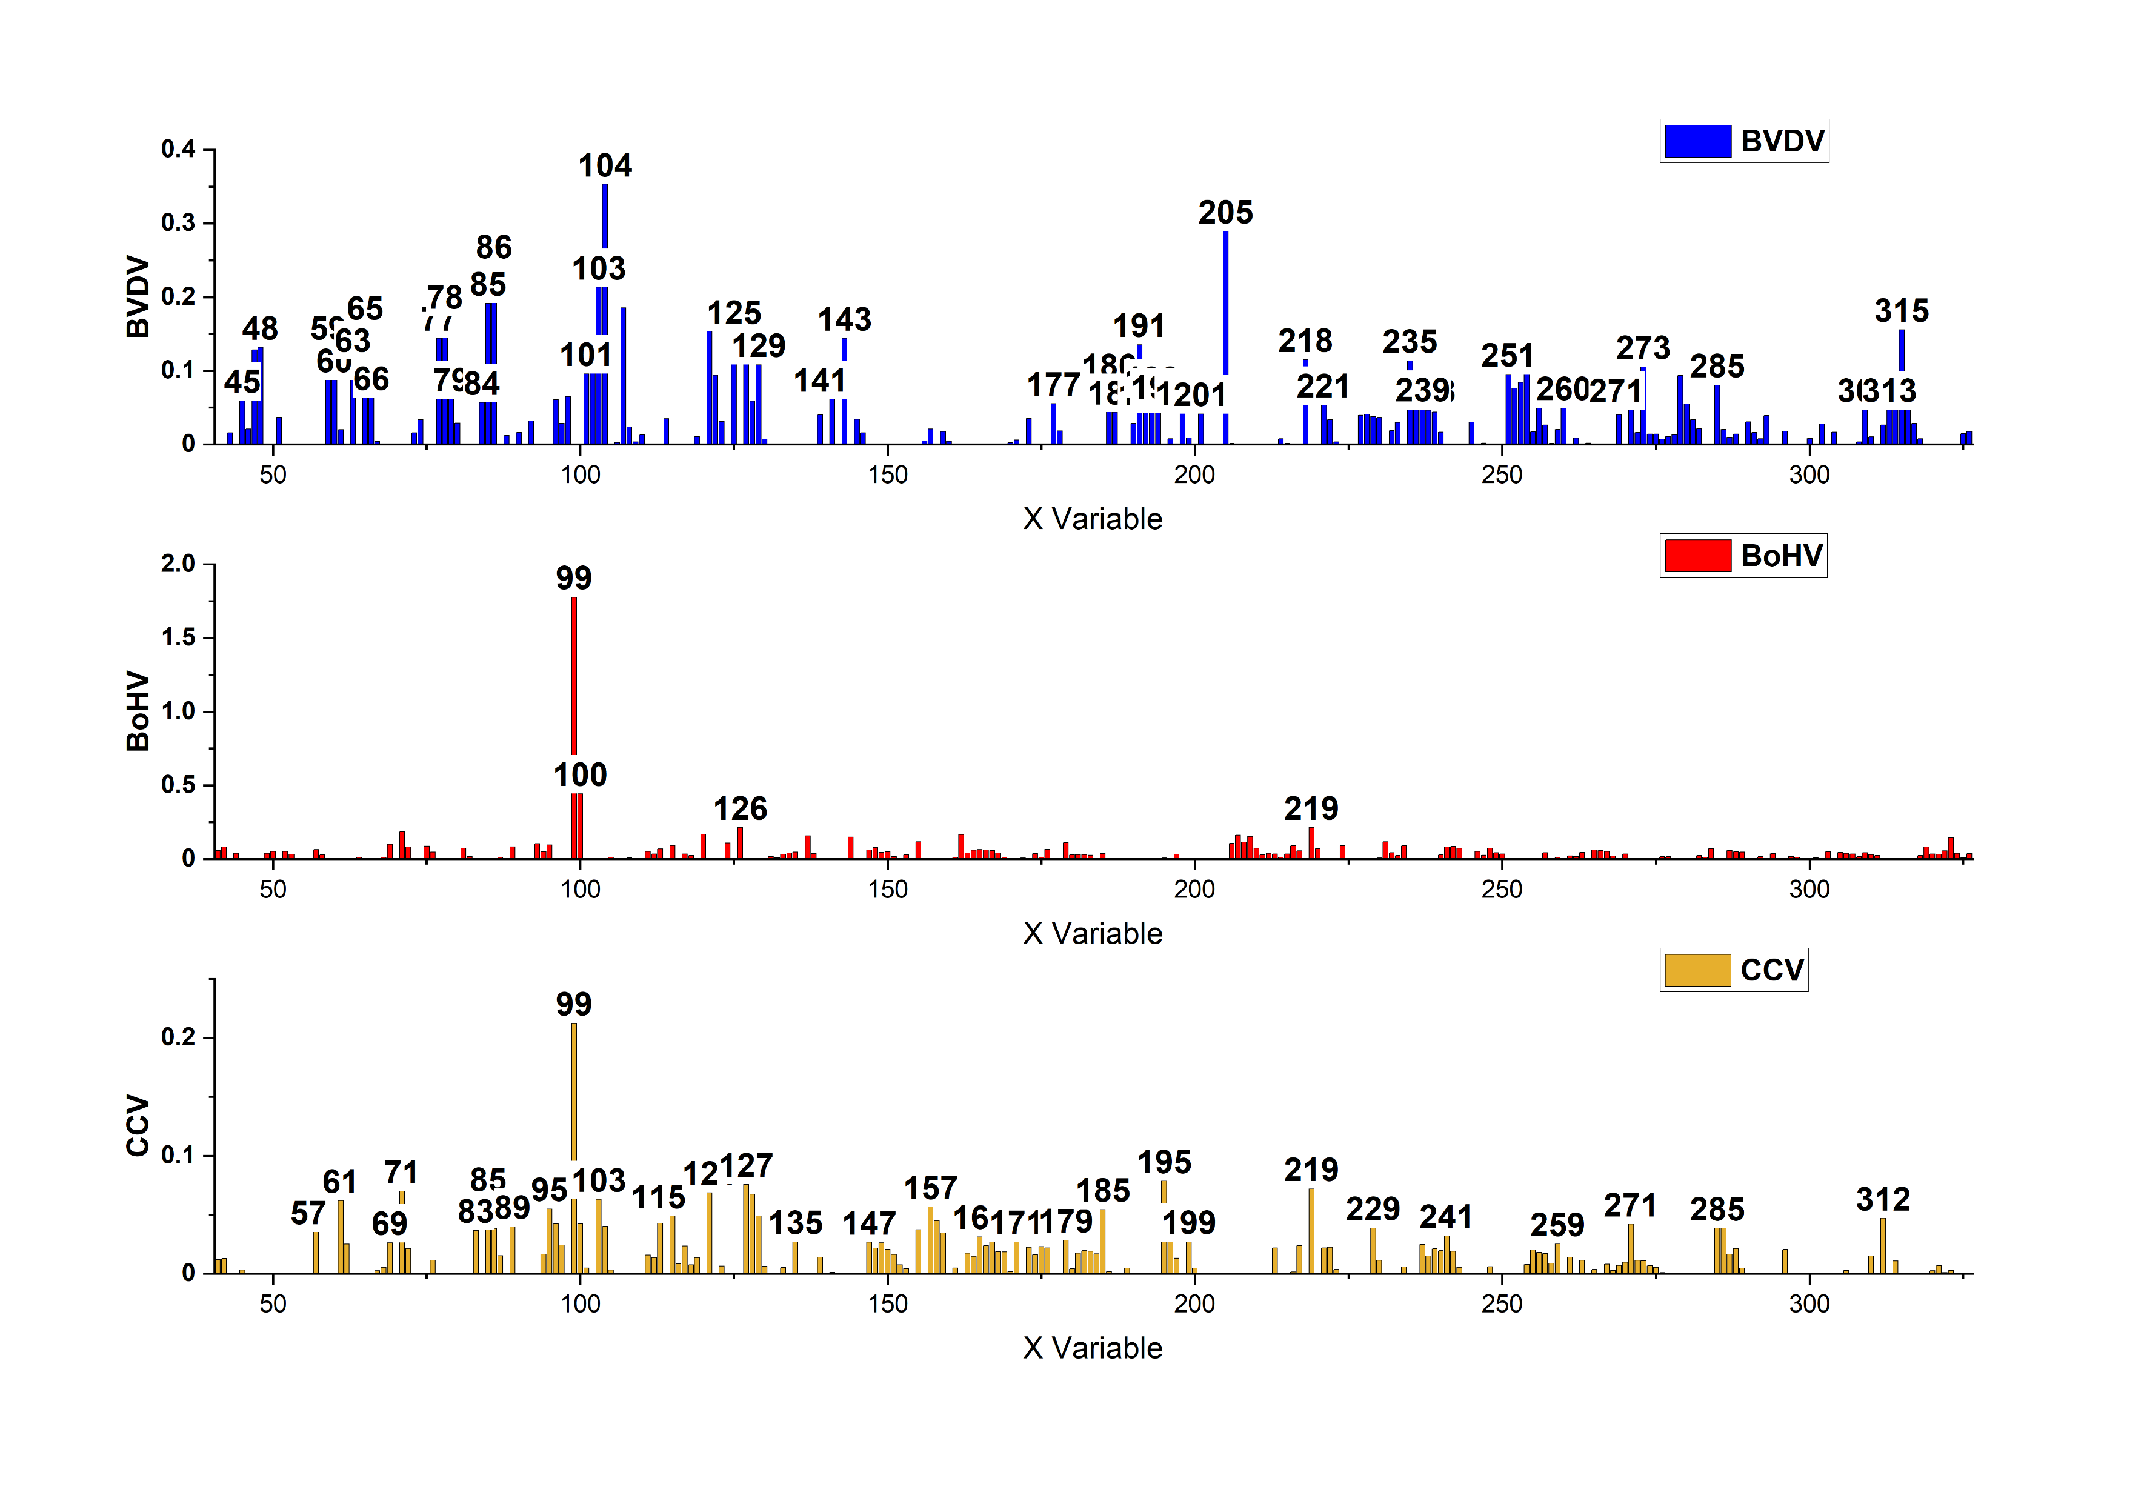
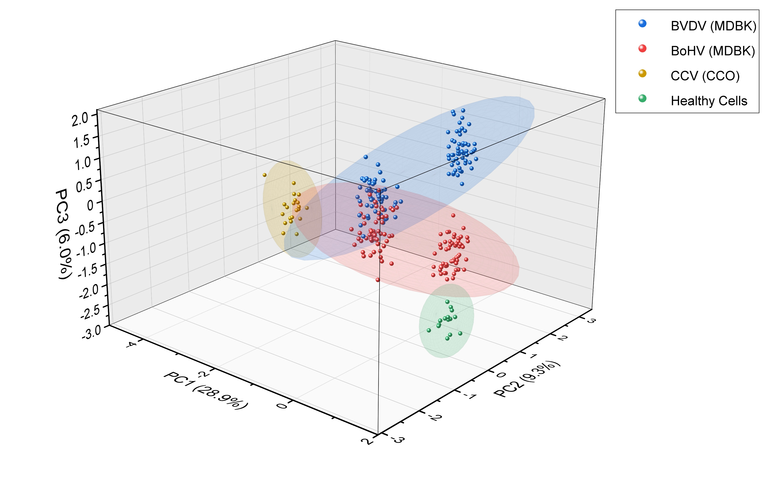
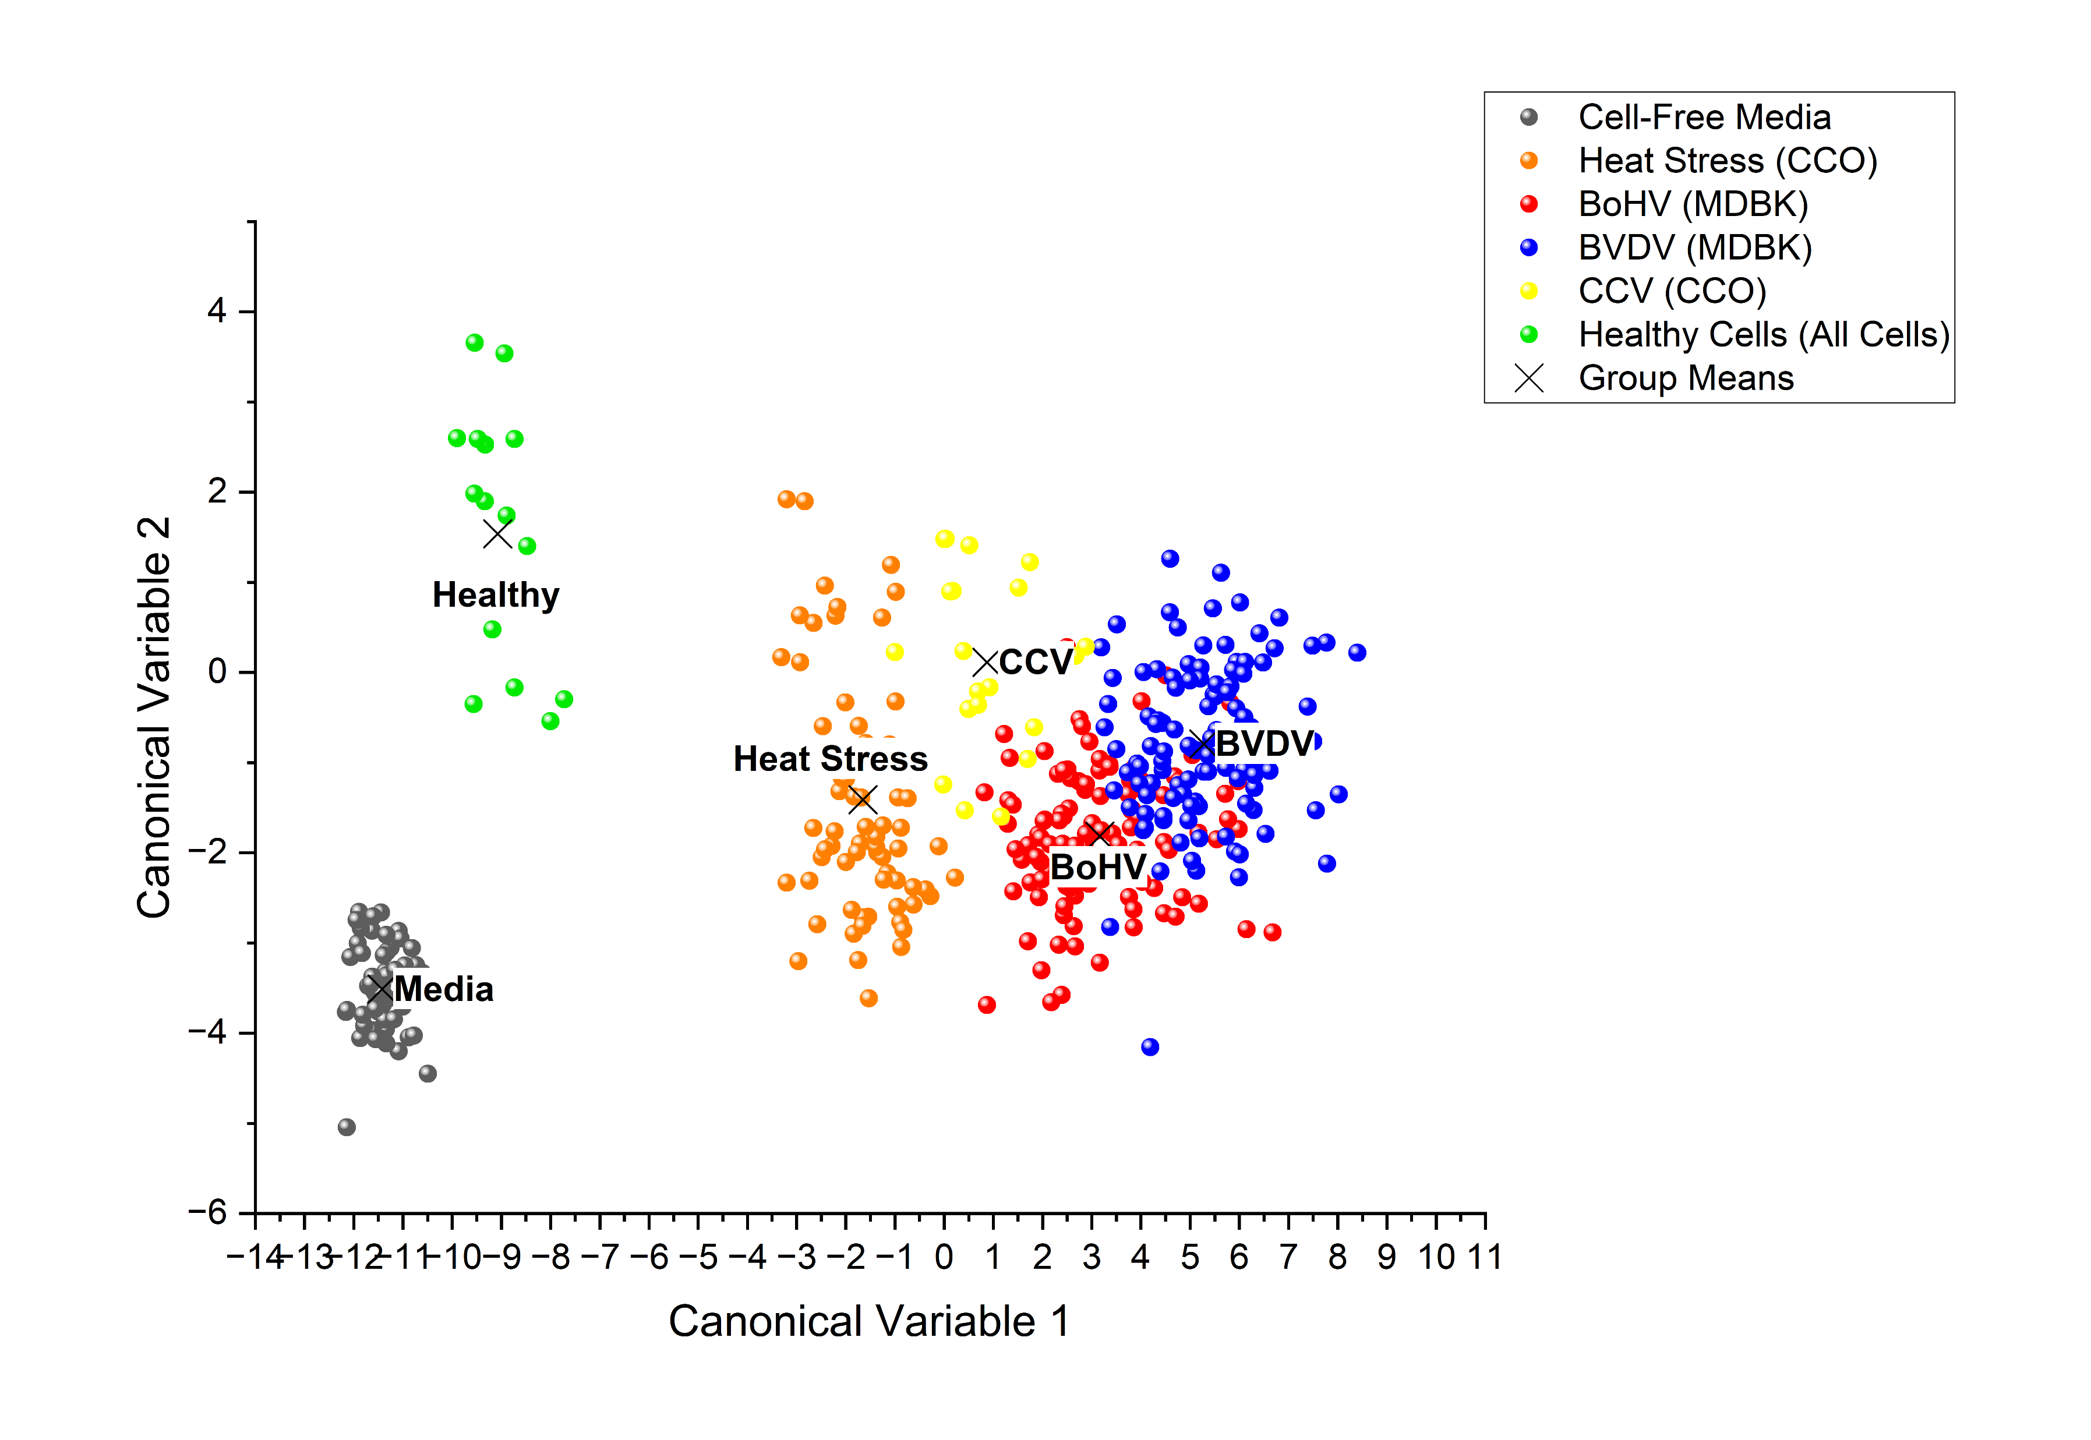
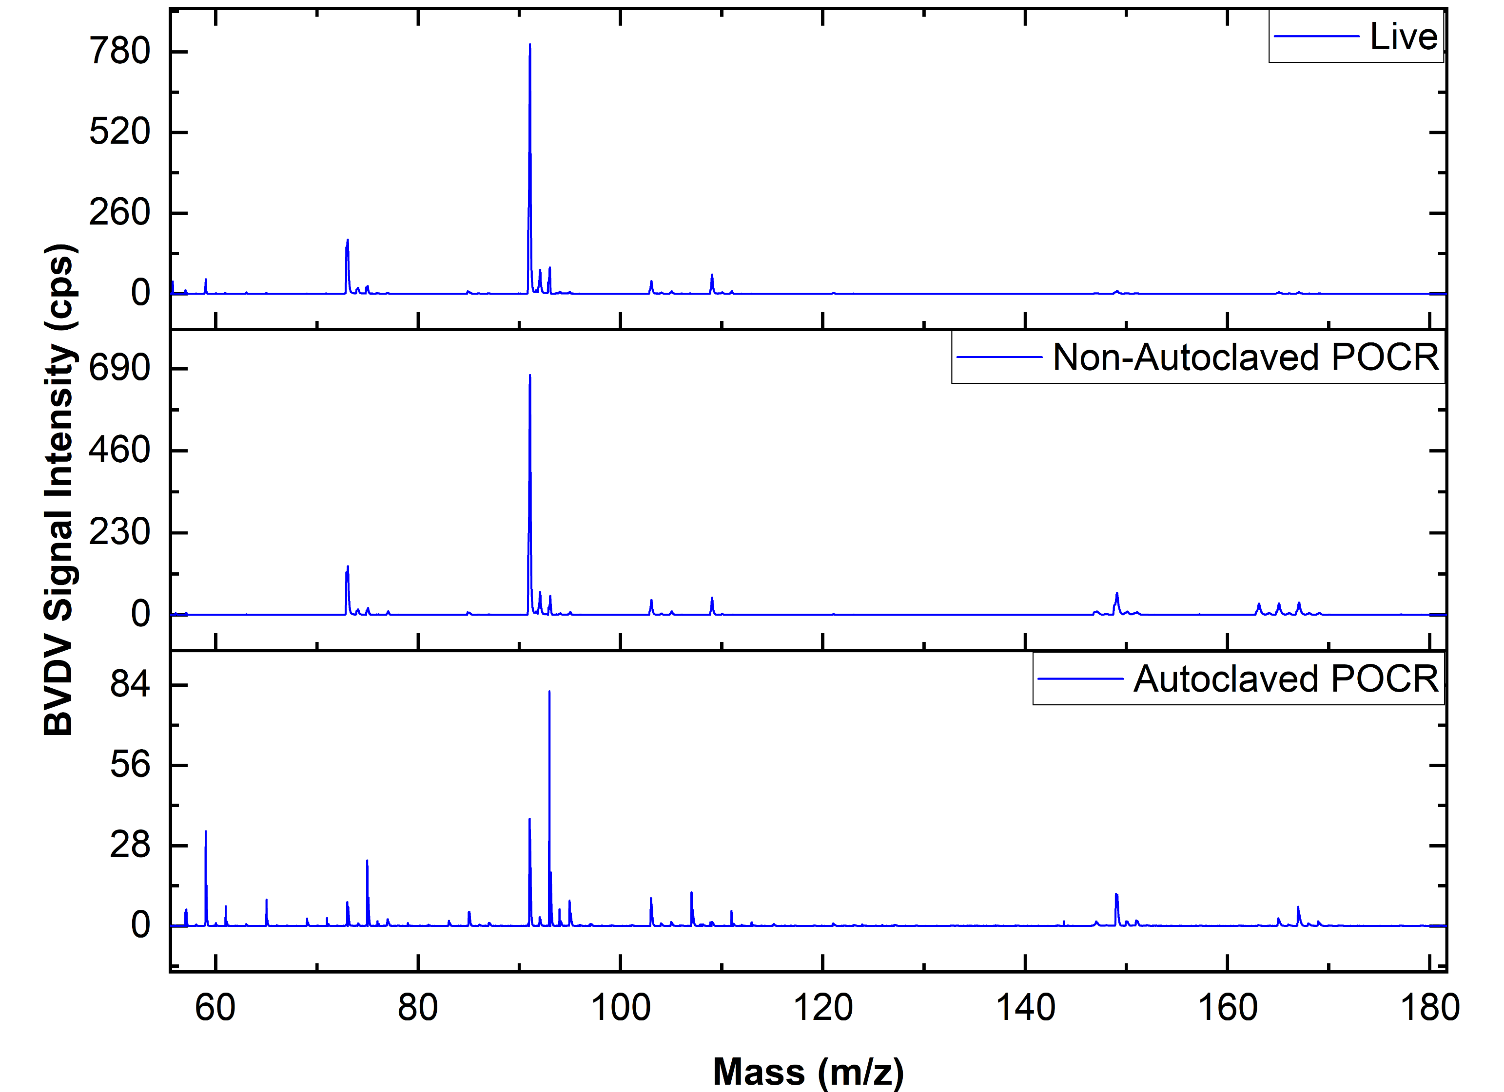
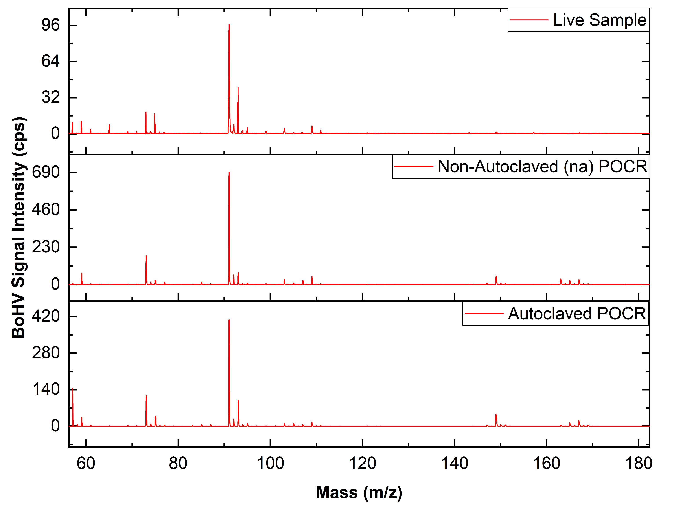
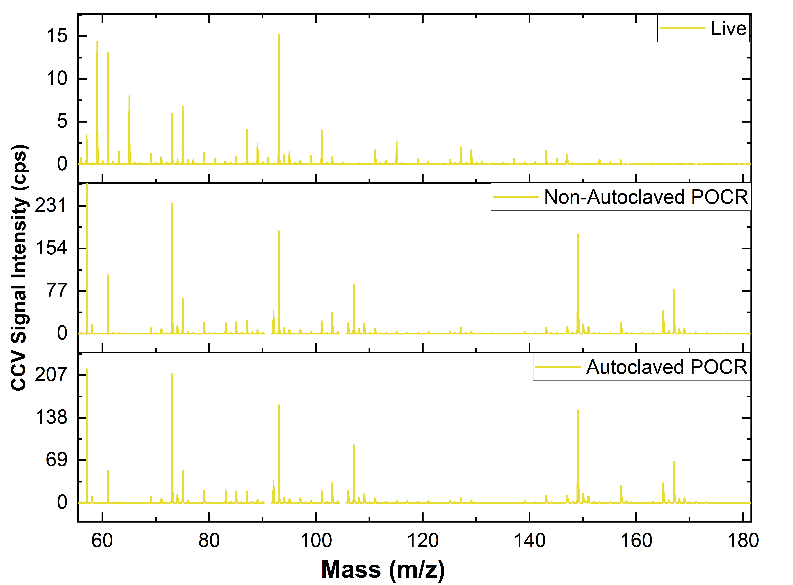
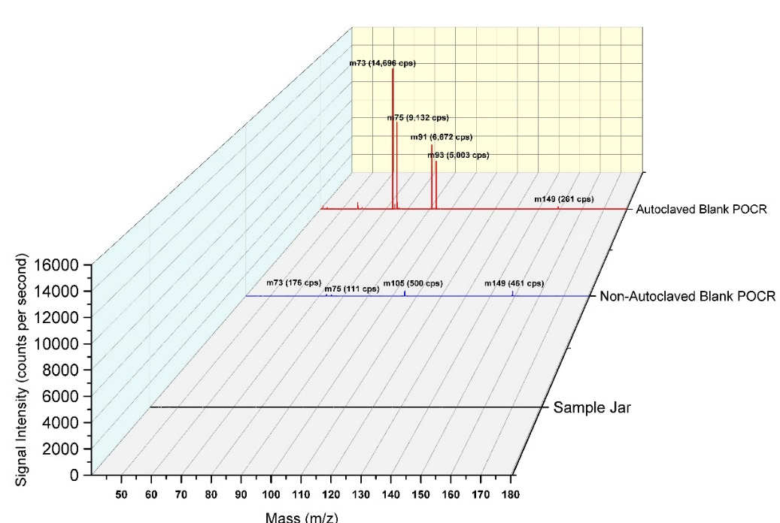
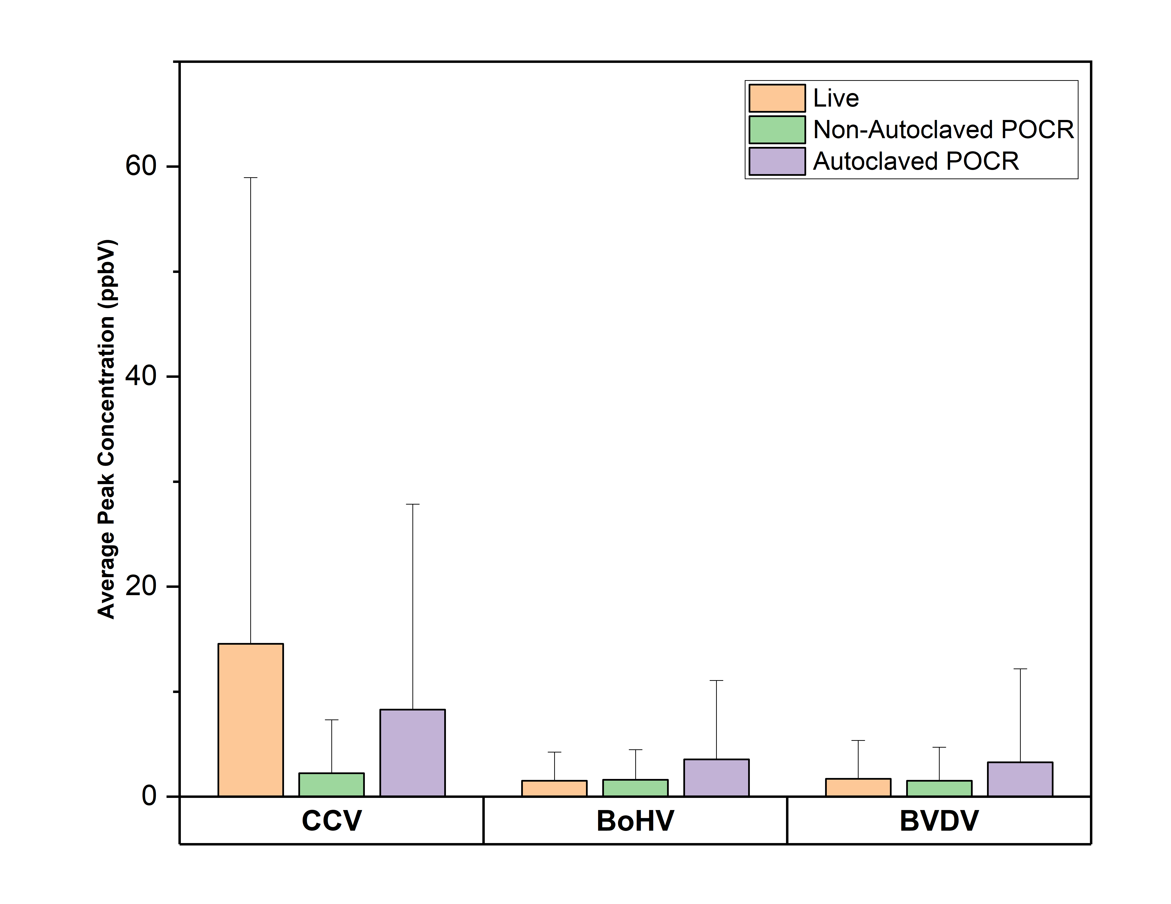
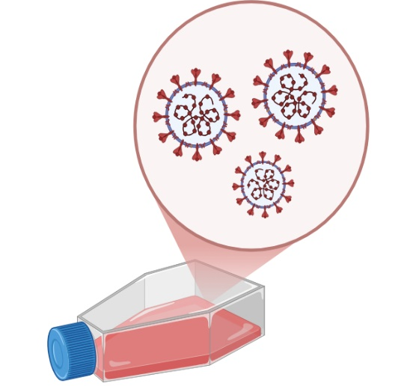
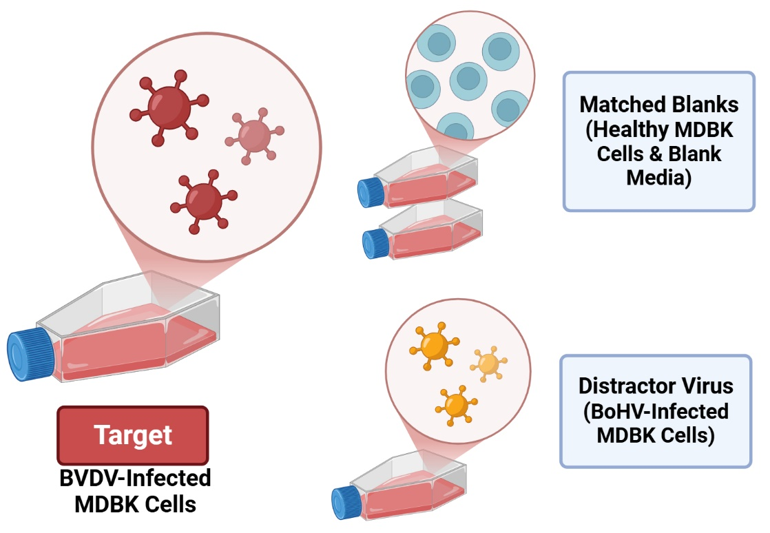
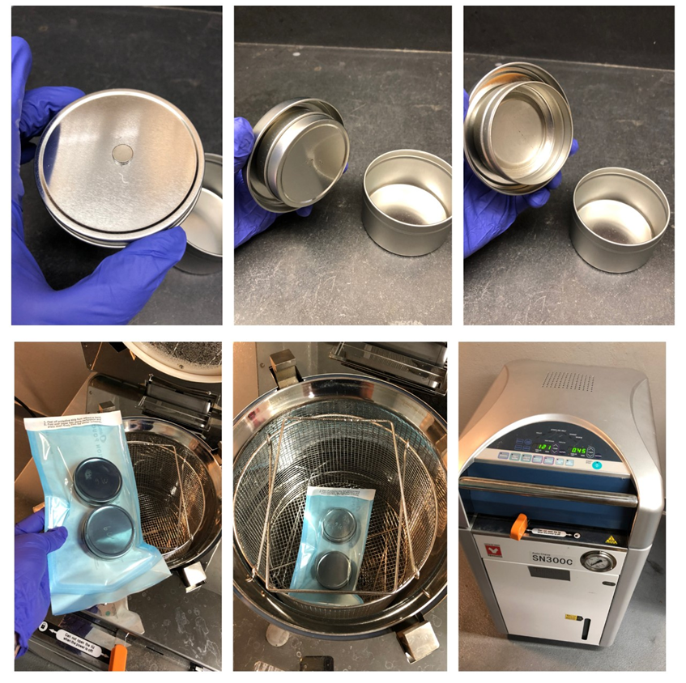
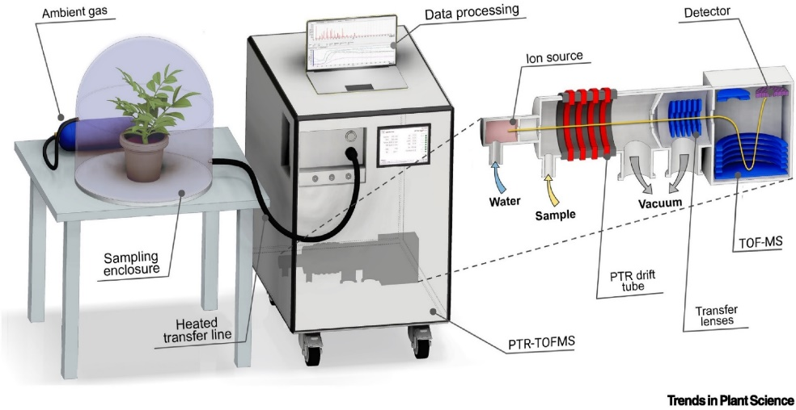
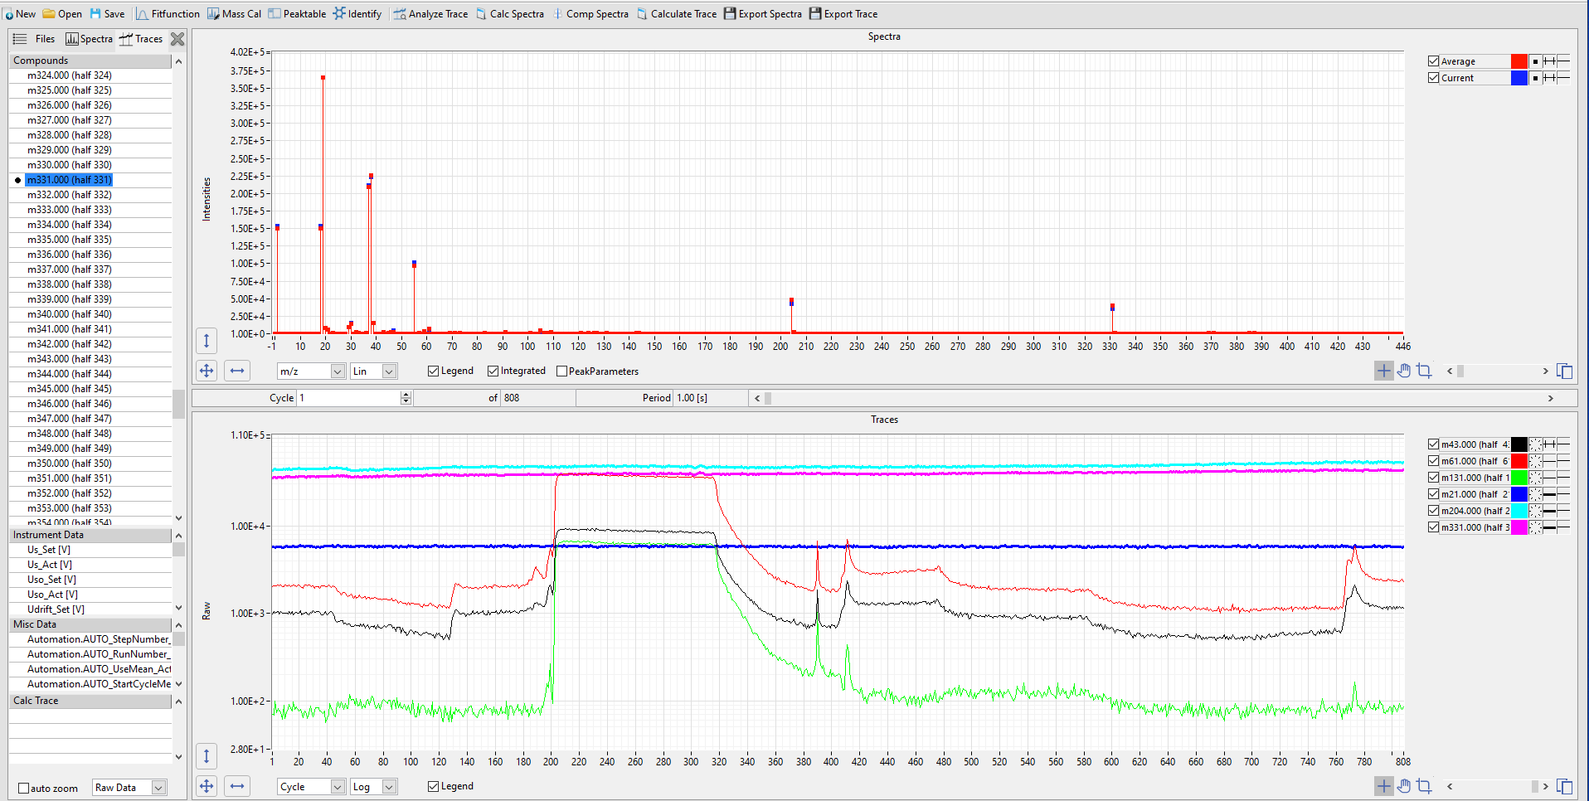
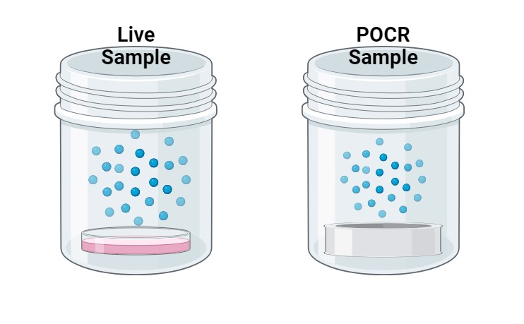
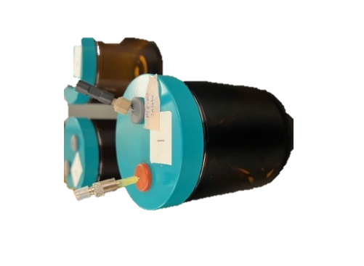
Headspace analysis of viral cell culture and odor transfer to polymer-based canine training aids for biological detection
Samantha Hagerty¹
Mentor: Melissa Singletary^{1,2} , Co-Authors: Michelle Aono¹, Adam Rivers³
¹Department of Anatomy, Physiology, and Pharmacology, Auburn University CVM, AL
²Canine Performance Sciences, Auburn University CVM, AL
³United States Department Agriculture, Agriculture Research Service
Introduction
Results
Emerging diseases and pathogens pose global public health risks that require rapid response and surveillance methods for effective containment & mitigation
The canine olfactory system is highly advanced and utilized across fields of odor detection, with recently emerging capacity in biological detection.
Representative peak features were identified for all virus groups through partial least squares (PLS) analysis of standardized spectra (Figure 2A), while partially overlapping confidence intervals observed in Principal Component Analysis (PCA) of live samples indicated a degree of shared features between viruses and greater variance compared to healthy cell and blank media (Figure 2B). Follow-up Linear Discriminant Analysis (LDA) including culture collected from alternatively stressed cells (heat stress) aligned with the PCA to show more overlap between stressed and non-stressed or blank media (Figure 2C).
A
B
C
Medical Detection Dogs™
Canine Olfactory System
Artist: Claus Lunau
Polymer-Based Odor Capture and Release (POCR™) Training Aid
There are unique challenges associated with bio-detection due to restricted access to source material outside of controlled facilities and complexity of odors¹.
In this work, we utilize polymer-based odor capture and release (POCR™)^{2,3} training aids to absorb and present the true odor of a biological agent for presentation to detection canines.
Cultured viruses include Channel Catfish Virus (CCV), Bovine Viral Diarrhea Virus (BVDV), and Bovine Herpes Virus (BoHV).
Figure 2. Comparative Analysis of Liquid (“Live”) Samples. A) PLS analysis isolated most representative peak features for each virus among all collected spectra. B) PCA showing spatial relationships and intragroup variance. C) LDA-based group classifications including virus-infected, heat-stressed, and healthy cells.
Research Aims
Unique peak signatures in live samples were also observed in ion chromatograms for charged POCR™ counterparts, demonstrating effective VOC transfer that persisted ever after being autoclaved, a protocol required for field use of virus-charged training aids outside of biosafety approved facilities (Figure 3).
Characterize volatile organic compound (VOC) profiles of 3 different viruses through headspace analysis of liquid-based culture samples
Evaluate odor signature transfer to polymer-based training aids after 24-hours of charging through proximal exposure to culture samples
Determine if autoclave sterilization of charged training aids affects odor profile
Figure 3. VOC Transfer to Charged Polymers. Representative chromatograms for live culture, non-autoclaved POCRs, and autoclaved POCRs for BVDV (blue), BoHV (red), and CCV (yellow).
Methods
A significant increase in polymer-associated background volatiles (siloxanes) are observed after autoclaving, as shown in the representative spectrum for blank POCRs (Figure 4A). However, the underlying sample-specific VOC peaks were still present at varied signal intensity. The total ion count for each group’s representative peaks were averaged across live, naPOCR, and aPOCR measurements, demonstrating similar detectable levels (Figure 4B).
A
B
Two cell lines (Channel Catfish Oocytes-CCO and Madin-Darby Bovine Kidney-MDBK cells) were propagated for inoculation with either CCV (6.25 x 10⁸ CCID₅₀/ml), BVDV (4.69 x 10⁶ CCID₅₀/ml), or BoHV (2.22 x 10⁷ CCID₅₀/ml) in respective lineages (Fig1A). Virus-infected and healthy cell lysate were harvested along with cell-free growth media.
A
B
Figure 4. Comparative Signal Intensity of Sample-Specific VOCs. A) Polymer-associated VOCs are elevated after autoclaving, increasing background odor on POCR samples, B) Underlying the POCR VOCs, sample-specific peaks were collectively averaged across respective sample types
Polydimethylsiloxane (PDMS)-based POCR™ training aids were charged with culture-derived volatiles through 24-hour controlled exposure to supernatant samples for direct comparative headspace analysis before and after standard biosafety sterilization (Fig1B).
CCV-Infected CCO
BVDV-Infected MDBK
BoHV-Infected MDBK
Healthy Cells CCO/MDBK
Discussion
C
Spectra
This work characterizes distinct volatile features of three cultured viruses and demonstrates effective odor absorption in polymer-based training aids that withstands sterilization. Common spectral patterns included possible presence of aldehydes, ketones, free fatty acids, and free radical compounds, though supplemental evaluation is needed for isobar deconvolution to confirm molecular identities. Further analysis will be conducted to determine the extent of biomaterial changes induced by autoclave treatment and whether this impacts canine generalization performance.
Signal Traces
Real-time headspace analysis using Proton Transfer Reaction - Time of Flight - Mass Spectrometry (PTR-TOF-MS, IONICON)⁶.
Adapted from illustration in Majchrzak et al. Trends in Plant Science, 2019
Acknowledgements & References
Figure 1. Sample Preparation and Headspace Analysis Workflow. A) MDBK and CCO cells were seeded in Minimum Essential Medium (MEM) and infected with respective viruses. B) Cured polymer in steel tin containers were suspended above 2ml of liquid culture samples for 24 hours to charge and subsequently autoclaved. C) POCR and liquid samples were enclosed in sealed jars for headspace analysis with PTR-MS instrument
This research is funded by the United States Department of Agriculture G00016151. Key References: 1) Canine training aids review (Simon, Lazarowski et al. 2020), 2) Preparation of polymer (MacCrehan, Young et al. 2020), 3) Validating use of POCRs for canine detection of BVDV target (Angle, Passler et al. 2015, Singletary, Krichbaum et al. 2022), 4) Odor dynamics (Sloan, Maughan et al. 2024), 5) Tandem instrument and canine odor analysis (Ong, Mendum et al. 2017), 6) PTR-MS method review and applications (Lindinger, Hansel et al. 1998)

