Slide 1

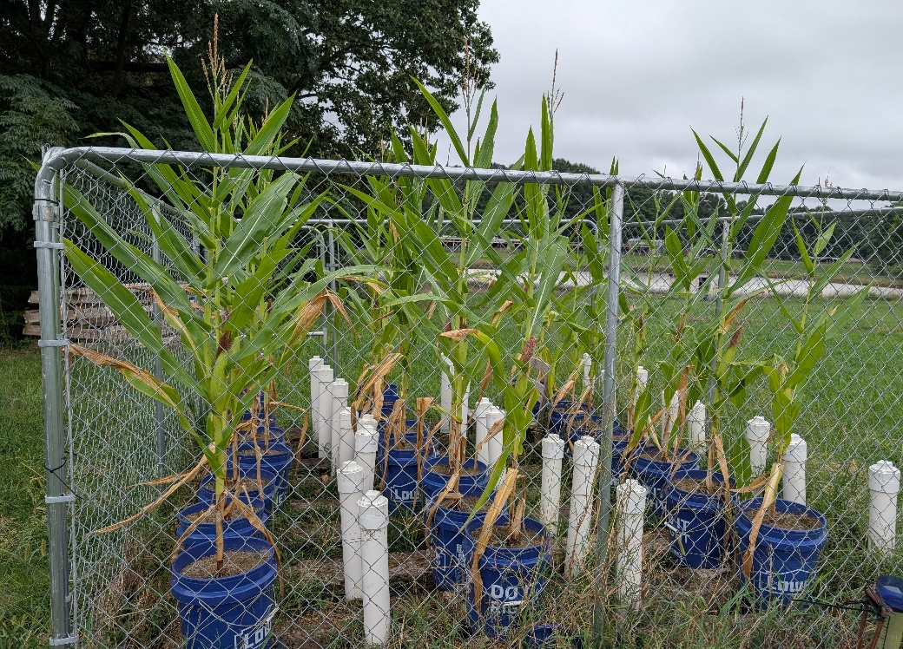
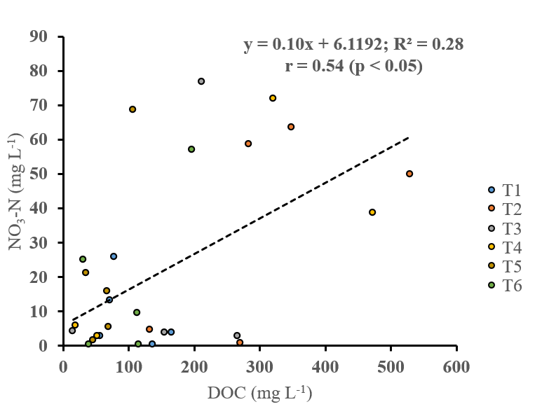
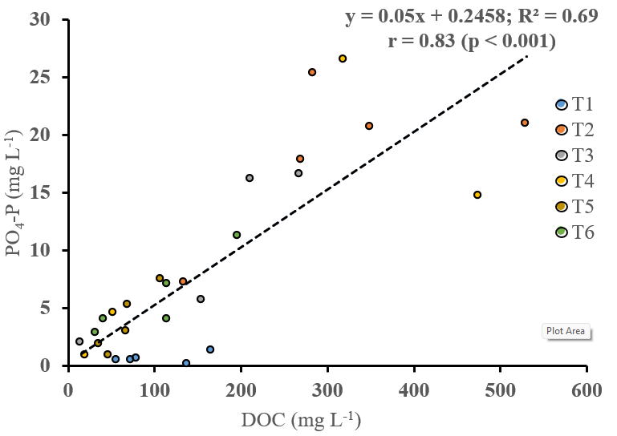
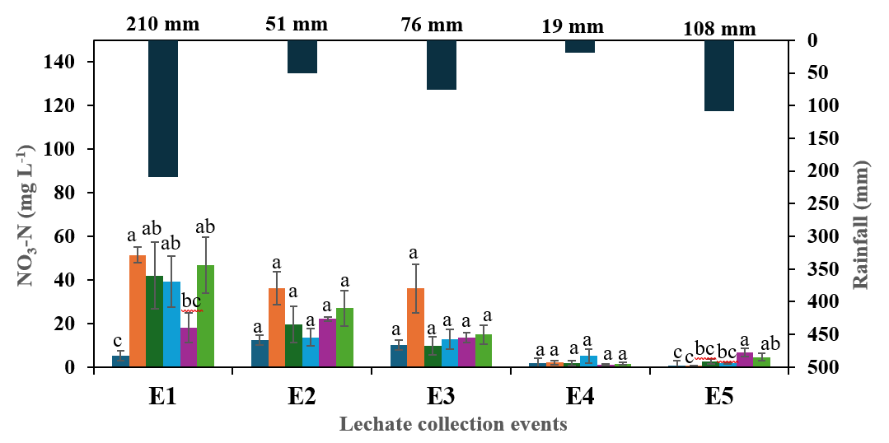
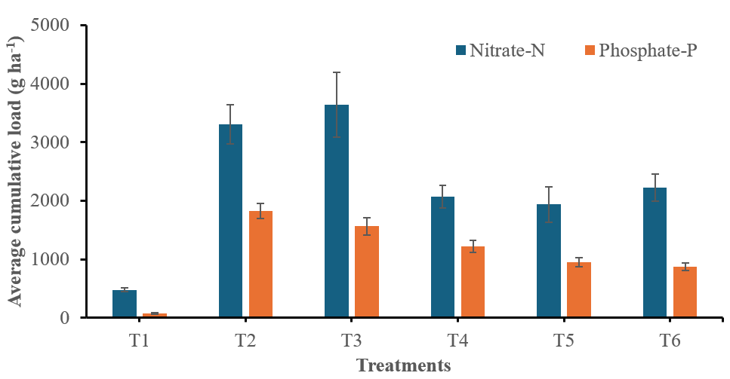
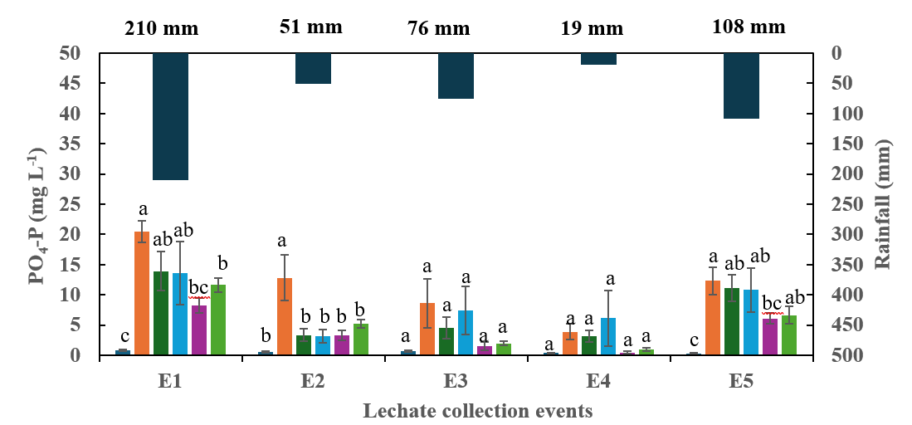
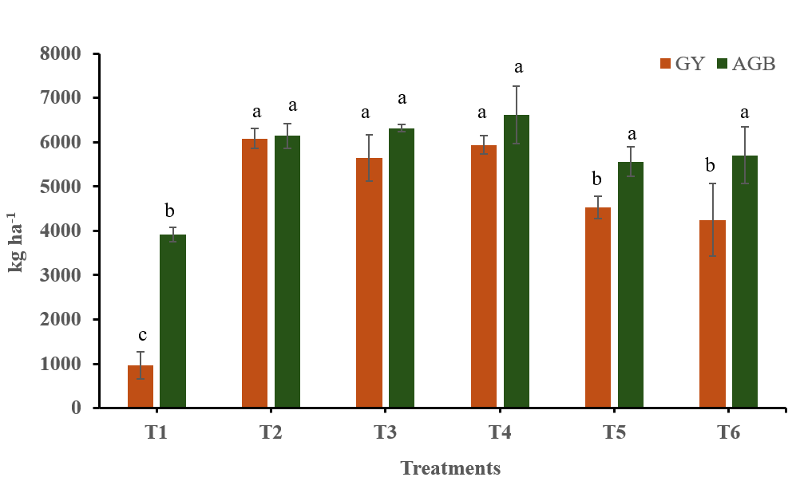
Assessment of Biochar, Alum, and Iron Sulfate on Nutrient Retention and DOC-Associated Leaching in Poultry Litter Amended Soils
Soura Shuvra Gupta¹, Rishi Prasad¹*, Debolina Chakraborty², and Prasenjit Ray¹
¹Animal Waste and Environmental Nutrient Management Laboratory, Department of Crop, Soil, and Environmental Sciences, Auburn University, Auburn, AL, United States,
²Department of Biosystems Engineering, Auburn University, Auburn, AL, United States
Discussion
Nitrate leaching was highest during initial rainfall events due to the loss of readily available nitrogen but declined as crop nutrient demand increased.
phosphate loss peaked during periods of heavy rainfall because greater water flux mobilized legacy phosphorus into the leachate.
Biochar showed limited nitrate retention due to its negatively charged surface, causing electrostatic repulsion, while phosphate was more effectively retained through inner-sphere complex formation (Laird et al. 2010).
Dissolved organic carbon (DOC) further influenced nutrient dynamics by stimulating microbial activity, enhancing nitrogen mineralization, and enzymatic conversion of organic P to inorganic phosphate, enhancing the leaching risk of nutrients (Dong et al. 2010)
Research methods
Results
An in-situ pot experiment under open field conditions
Soil: Loamy sand (0-15 cm)
Crop: Corn (Zea mays var. DKC70-45)
Treatments:
soil without PL (T1)
soil with 20 t ha⁻¹ PL (T2)
soil with 20 t ha⁻¹ PL + 10% BC-1 (T3)
soil with 20 t ha⁻¹ PL + 10% BC-2 (T4)
soil with 20 t ha⁻¹ PL + 10% alum (T5)
soil with 20 t ha⁻¹ PL + 10% iron sulfate (T6)
Replications: 4
Design: CRD
Rainfall events: 5
E1 (210 mm) = 1 day before planting
E2 (51 mm) = 4 days after planting
E3 (76 mm) = 20 days after planting
E4 (19 mm) = 40 days after planting
E5 (108 mm) = 65 days after planting
The concentration of NO₃-N significantly varied across crop growth stages, while PO₄-P concentration was influenced by rainfall amount (Fig 2).
Across five rainfall events, amendments reduced cumulative average PO₄-P loading by 14.5% (BC-1), 33% (BC-2), 48% (alum), and 52% (iron sulfate), reflecting that alum and iron sulfate were more effective in reducing PO₄-P leaching while BC exhibited variable performances (Fig 3A)
DOC exhibited significant positive correlations with NO₃-N (r = 0.54, p < 0.05) and PO₄-P (r = 0.83, p < 0.001) (Fig 4)
Grain yield was similar in unamended and BC-amended soils, significantly higher than alum- and iron sulfate-amended soils (Fig 3 B)
HEADING FOR CHART/DIAGRAM
Fig 1: An overview of the experimental setup
A
B
Introduction
Repeated manure applications can cause gradual nitrate (NO₃-N) leaching and the accumulation of phosphorus (P) throughout the soil profile
The excess P (legacy P) leaches in the form of dissolved P (PO₄-P) and poses a persistent threat to groundwater quality (Dari et al., 2018).
Conventional amendments, i.e., alum and iron sulfate, effectively immobilize nutrients but may induce soil acidification.
The role of BC can be a sustainable alternative to restrict nutrient movement..
A
A
Fig 4: Relationships between (A) NO₃–N and (B) PO₄–P and dissolved organic carbon (DOC) in leachate collected during different rainfall events across treatments.
Research question
Acknowledgements: The authors are thankful to the Department of Crop, Soil, and Environmental Sciences, Auburn University, for providing the necessary facilities to carry out the research. The authors thank Waters Agricultural Laboratory (Georgia, USA) for the timely and proficient nutrient analysis of plant samples
Does biochar outperform conventional amendments such as iron sulfate and alum in enhancing plant growth and nutrient retention in poultry-manured soils?
B
B
Objectives
References:
Dari, B., Nair, V. D., Sharpley, A. N., Kleinman, P., Franklin, D., & Harris, W. G. (2018). Consistency of the threshold phosphorus saturation ratio across a wide geographic range of acid soils. Agrosystems, Geosciences & Environment, 1(1), 1-8.
Dong, X. M., Ma, S. N., Wang, H. J., Li, Y. Y., Li, Y., & Xu, J. L. (2022). Dissolved organic carbon loading stimulates sediment phosphorus mobilization and release: preliminary evidence from Xiangshan Port, East China Sea. Frontiers in Environmental Science, 9, 782701.
Laird, D., Fleming, P., Wang, B., Horton, R., & Karlen, D. (2010). Biochar impact on nutrient leaching from a Midwestern agricultural soil. Geoderma, 158(3-4), 436-442
To compare the efficacy of biochar (BC) with alum and iron sulfate in mitigating nutrient leaching
To investigate the relationship between dissolved organic carbon (DOC), nitrate (NO₃-N), and phosphate (PO₄-P) to assess their contribution to nutrient leaching
The role of different amendments on plant nutrient uptake and grain yield
Fig 2: Average concentrations of (A) NO₃–N (mg L⁻¹) and (B) PO₄–P (mg L⁻¹) in leachate over five rainfall events (shown in secondary Y-axis). Bars represent means ± standard errors.
Fig 3: (A) Average cumulative load (g ha⁻¹) of nitrate-N (NO₃-N) and phosphate-P (PO₄-P) across treatments following five rainfall events
(B) Effect of treatments on corn above‑ground biomass (AGB) and grain yield (GY).

