Slide 1

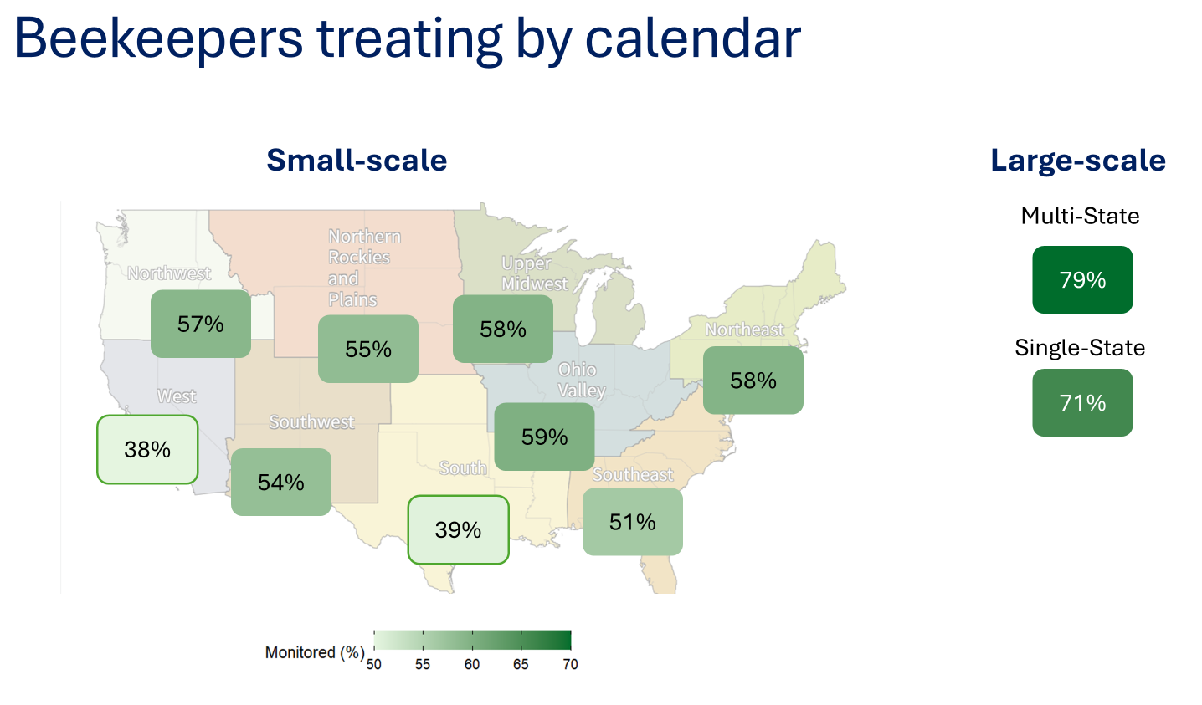
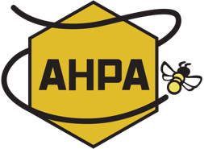
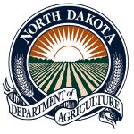
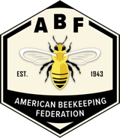
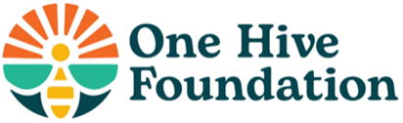
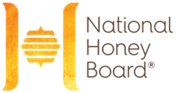

The US Beekeeping Survey: Integrated Pest Management for Varroa is associated with lower colony losses
Agostina Giacobino¹, Nathalie Steinhauer², Geoffrey Williams¹
¹Bee Center, Department of Entomology and Plant Pathology, Auburn University, Auburn, AL
²Department of Horticulture, Oregon State Corvallis, OR
Introduction
Long-term monitoring of managed Apis mellifera honey bee colony losses is critical for documenting the magnitude of this globally significant issue. Since 2024, the Auburn University Bee Center has continued previous efforts by leading the U.S. Beekeeping Survey, designed to estimate colony losses in the United States. The survey also provides a platform to collect data on management practices across regions and operation types, particularly those related to Varroa destructor management (Haber et al., 2019), which is a major threat to the beekeeping industry.
Methods
We analyzed 1,442 and 2,318 responses from the 2023-2024 and 2024-2025 surveys, respectively.
Operations were classified as large-scale (>50 colonies) or small-scale (≤50 colonies), with large-scale subdivided into single-state (SS) and multi-state (MS) and small-scale operations grouped into nine climatically consistent NOAA-defined regions.
We described V. destructor management practices by group and evaluated associations with winter losses using a generalized linear mixed model.
Results
About half of large-scale MS operations reported using pesticides (varroacides) as their primary method for Varroa control, and 70–80% reported monitoring colonies; however, many treated on a calendar-based schedule, based on the time of the year and without considering infestation levels (Fig.1). In contrast, only 30% of large-scale SS operations relied primarily on varroacides, with 60–70% reporting colony monitoring. Small-scale operations showed strong regional variation; 40-79% integrated chemical and non-chemical methods, most often organic varroacides and screened bottom boards. Between 40-70% monitored annually, and calendar-based treatments were less common than in large-scale operations ( Fig. 1).
Fig 1. Proportion of small-scale beekeepers across U.S (left) and large-scale beekeepers (right) treating their honey bee colonies against Varroa destructor based on a calendar schedule. Map source: NCEI
Across all beekeeper groups, incorporating monitoring results alongside calendar-based treatment decisions (χ² = 10.43, P = 0.001) and rotating more than one active ingredient (χ² = 21.53, P = 0.001) were associated with lower winter losses. Within small-scale operations, winter losses also varied by region (Fig. 2).
Fig 2. Predicted winter losses for honey bee colonies by chemical type of varroacides (left), trigger to treat with of varroacides (center) and region (right).
Ref: Chemical type (Synthetic varroacides=Synt, Essential oils=EO, Organic varroacides=Org). Region (Northeast=NE, North Rockies and plains=NRP, Northwest=NW, Ohio Valley=OV, South=S, Southeast=SE, Southwest=SW, Upper Midwest=UMW, West=W).
Discussion
Effective V. destructor control remains a priority in managed honey bee colonies, and evaluating current practices can inform the development of targeted educational programs that promote integrated pest management (Steinhauer & Saegerman, 2021).
References
Funding
Haber, A. I., Steinhauer, N. A., & VanEngelsdorp, D. (2019). Use of chemical and nonchemical methods for the control of Varroa destructor (Acari: Varroidae) and associated winter colony losses in US beekeeping operations. Journal of Economic Entomology, 112(4), 1509-1525. https://doi.org/10.1093/jee/toz088
Steinhauer, N., & Saegerman, C. (2021). Prioritizing changes in management practices associated with reduced winter honey bee colony losses for US beekeepers. Science of The Total Environment, 753, 141629. https://doi.org/10.1016/j.scitotenv.2020.141629
Notes:
Data available but not included: brood, honey, or pollen.
References as QR code?
Acknowledgements section for bee lab members and local beekeeper volunteers?

