Slide 1

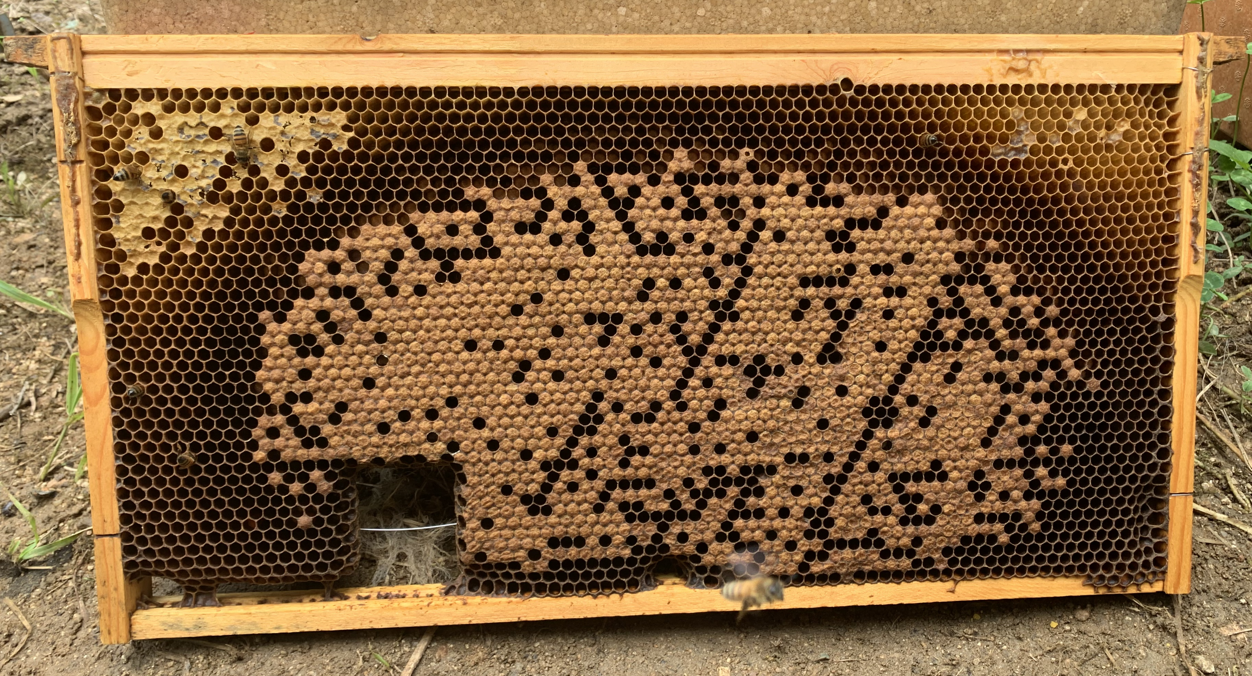
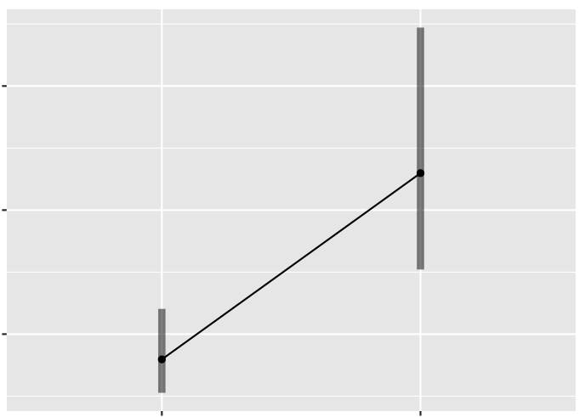
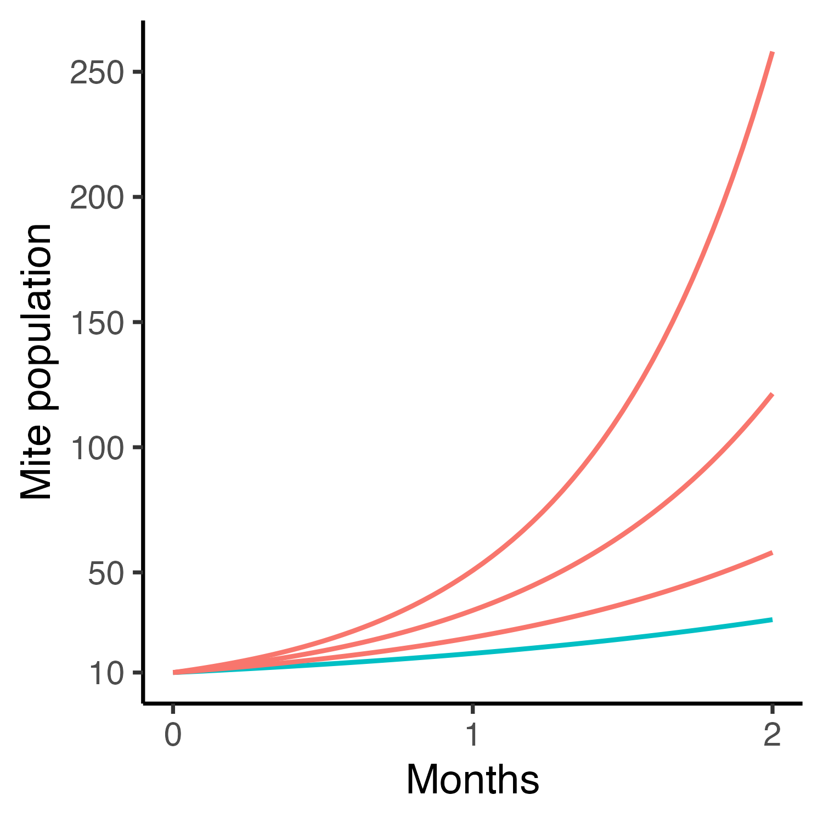
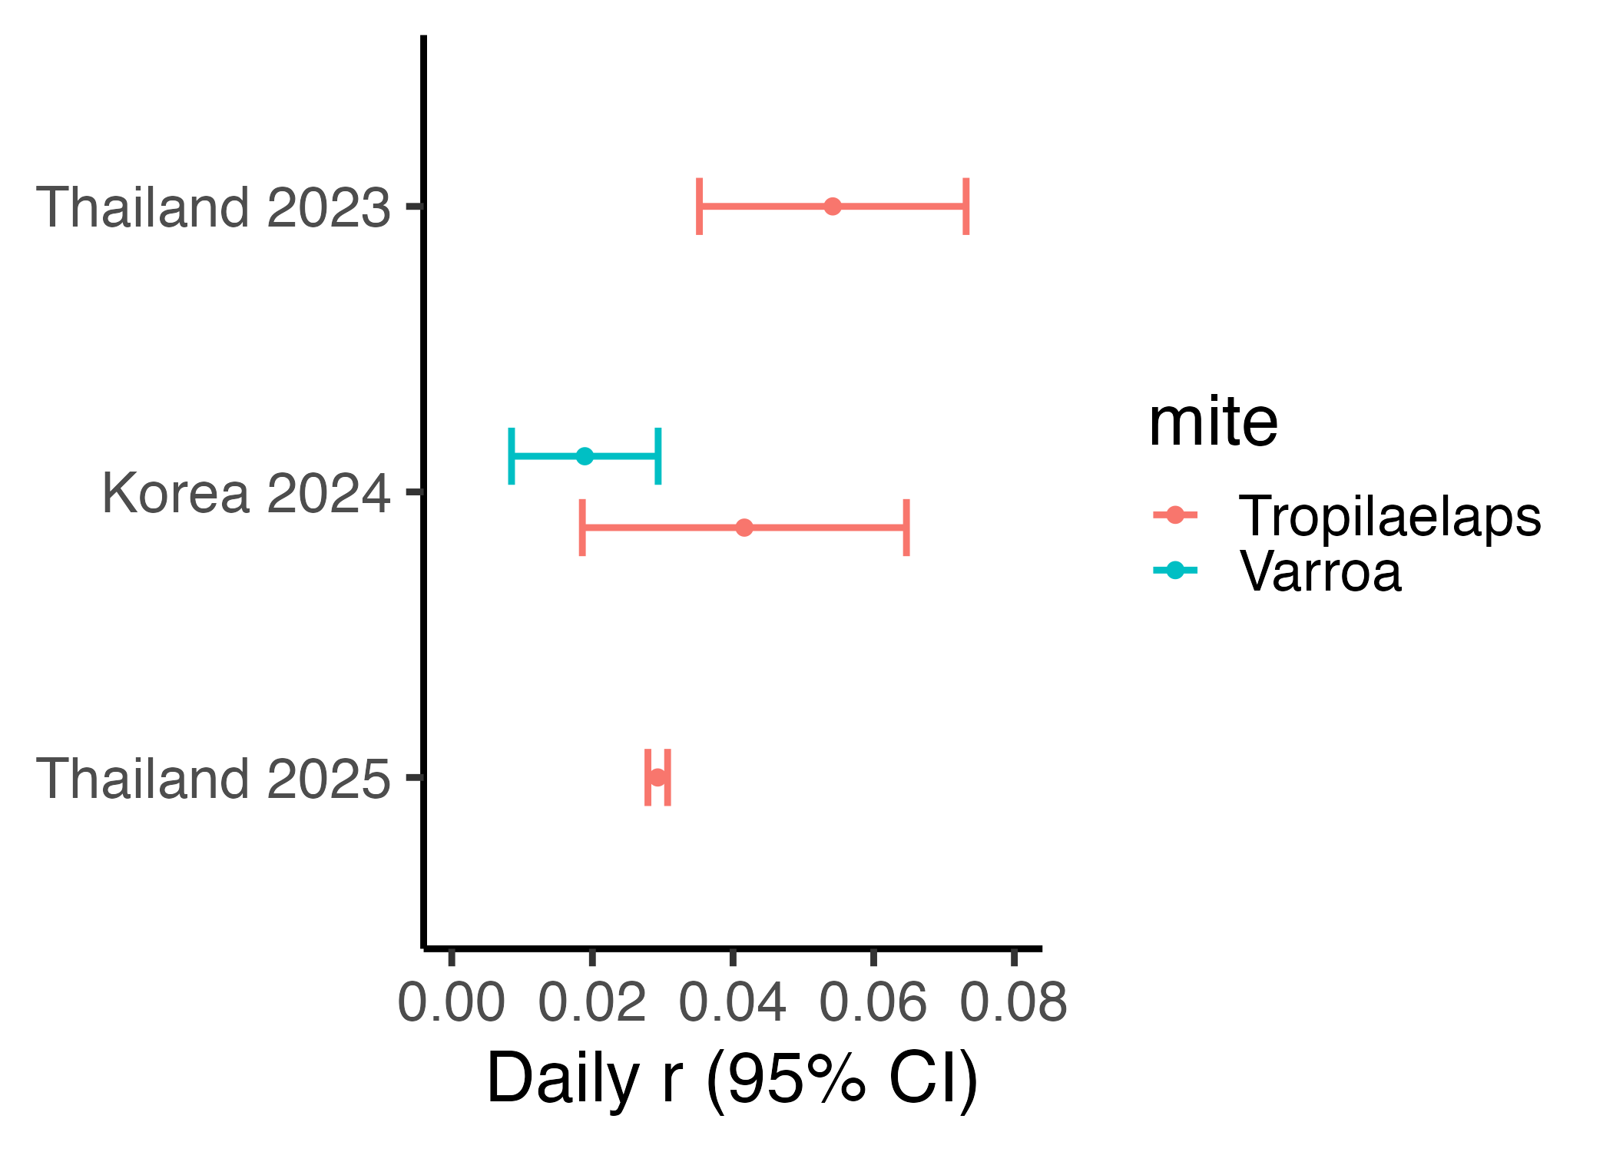






Diagram showing experimental design. To estimate the whole-colony populations of the honey bee parasitic mites Tropilaelaps and Varroa, the visually estimated number of honey bee young was multiplied by the infestation rate of honey bee young by both mites. Mite population was estimated at the start and end of observation periods to determine the fold-increase of Tropilaelaps and Varroa populations.
Tropilaelaps vs. Varroa:
Comparing population growth of two important honey bee parasitic mites
Dan Aurell¹, Rogan Tokach¹, Bajaree Chuttong², Pichet Praphawilai², Léna Barascou¹, Selina Bruckner1, Chuleui Jung³, Hyunha Oh³, Geoff Williams¹
¹Auburn University, USA
²Chiang Mai University, Thailand
³Gyeongkuk National University, Republic of Korea
Fig 1. Parasitic mites are considered the most important stressors of Apis mellifera honey bee colonies. Left: Varroa destructor. Right: Tropilaelaps mercedesae. Photo: Rogan Tokach & Anthony Abbate.
Introduction
Tropilaelaps mercedesae is a damaging parasitic mite that has jumped onto Asian populations of Apis mellifera honey bees – and is spreading
In regions with mild winters, populations of Tropilaelaps mercedesae dominate over populations of Varroa destructor (Woyke, 1987) but Tropilaelaps population growth rate has never been assessed
This makes it difficult to estimate the time it takes for populations to grow to levels that damage colonies, promote spread to other colonies, and require beekeeper management
Experimental design
Whole-colony Tropilaelaps and Varroa populations determined as:
Assessed at the start and end of observation periods:
Number of honey bee young
Infestation rate of honey bee young
Tropilaelaps population
Start
End
Fig 2. Experimental design flow chart. Two investigations were conducted in Thailand and one was conducted in Korea.
Objectives
Determine population growth rate of Tropilaelaps mercedesae mites in whole honey bee colonies
Compare Tropilaelaps mercedesae population growth to that of Varroa destructor
Response variables
Population of Tropilaelaps mercedesae and Varroa destructor mites per colony
Results and discussion
Study – Population growth
Thailand 2023 – 25.8-fold
Starting with
10 mites
Korea 2024 – 12.1-fold
Thailand 2025 – 5.8-fold
Korea 2024 – 3.1-fold
Fig 3. Population growth of Tropilaelaps and Varroa mites in honey bee colonies over a 2-month period.
We found a daily rate of population increase for Tropilaelaps of 0.042, whereas Varroa populations generally increase at a rate of 0.021 (Martin, 1998)
Extrapolating to a beekeeping year, we predict that Tropilaelaps mites cause substantial problems after only 3-6 months, whereas Varroa mites take about 9 months to rise to damaging levels
Predictions of Tropilaelaps population growth will help prepare responses to new incursions and prepare management guidance for beekeepers
References
Funding
Martin, 1998. Ecological Modelling 109(3).
Woyke, 1987. Journal of Apicultural Research 26(3).

